Slide 1

Regional strategy for climate resilient infrastructure
Prof. Sanda Midžić Kurtagić,
Center for Environment, Energy and Resources- CENER 21
Mike Woning, Deltares

Slide 2
Preparation of the strategy
Stakeholder inputs
National consultants
International consultants
Trainings
Webinars
Conferences
Guidelines
Regional Strategy
Capacity Building

Slide 3

The Strategy
Albania
B&H
Climate change projections in the region
Road infrastructure vulnerability on climate change
Resilience Planning in Road Infrastructure Development
Risk assessment and management
Road map for adaptation planning
N.
Macedonia
Montenegro
Serbia
Kosovo*
*This designation is without prejudice to positions on status and is in line with UNSCR 1244 and the ICJ Opinion on the Kosovo Declaration of Independence.

Slide 4
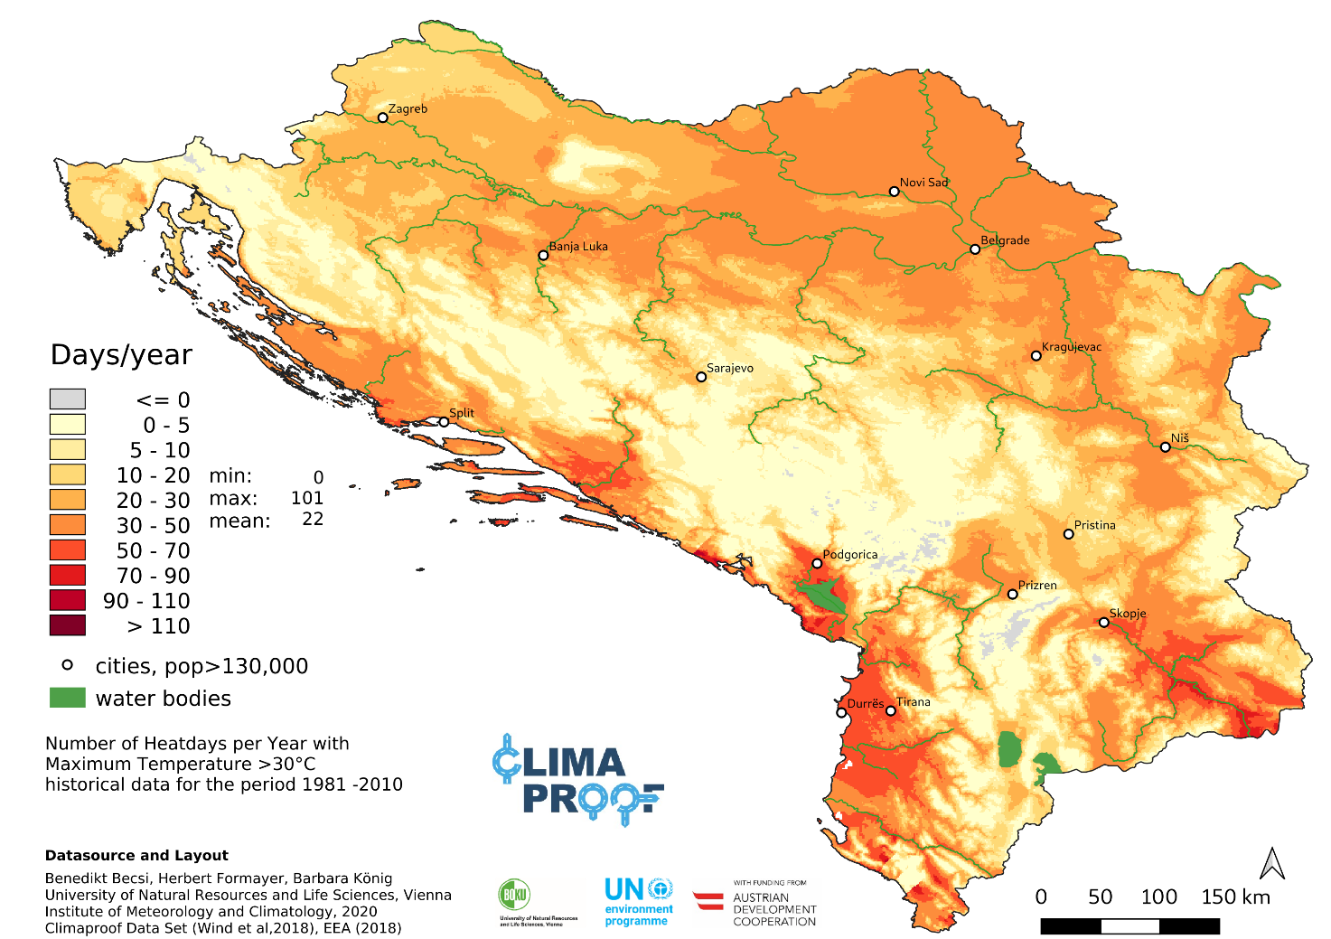
Climate change projections in the region
Climate projections until year 2100
Clima Proof (High Resolution Climate Change Projections for road infrastructure planning, development and maintenance )
Climate Change in the West Balkans, Zoï Environment Network on behalf of UNEP 2012
Study on climate change in the Western Balkans Region, Regional Cooperation Council 2020
National communication documents under the UNFCC (contracting parties)

Slide 5
Hazard level
Natural hazard | Albania | Bosnia and Herzegovina | Montengero | N. Macedonia | Serbia | Kosovo*
River flood | High | High | High | High | High | High
Urban flood | High | High | High | High | High | High
Coastal flood | Medium | Medium | Medium | - | - | -
Earthquake | Medium | Medium | Medium | High | Medium | Medium
Landslide | High | High | High | Medium | Medium | High
Tsunami | Medium | Low | Low | Medium | - | Medium
Water scarcity | Medium | Medium | Medium | High | High | High
Extreme heat | High | Medium | Medium | High | High | High
Wildfire | High | High | High | High | High | High

Slide 6
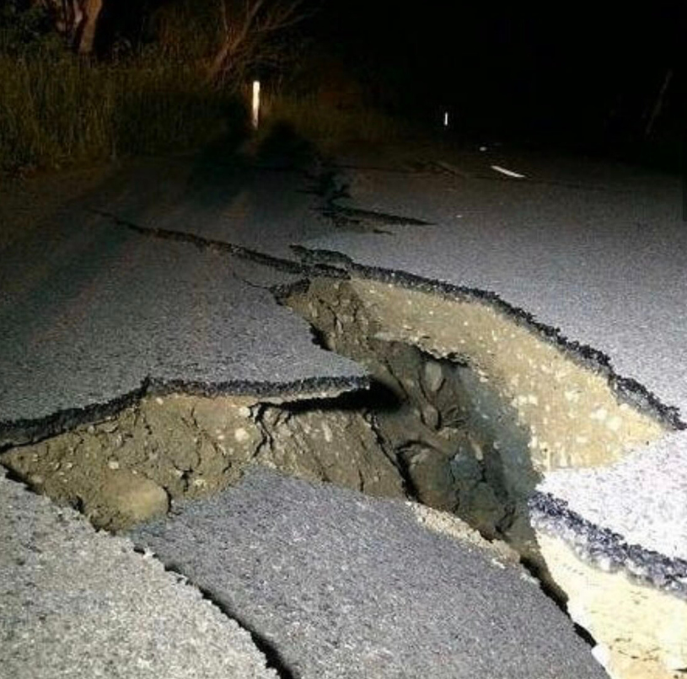
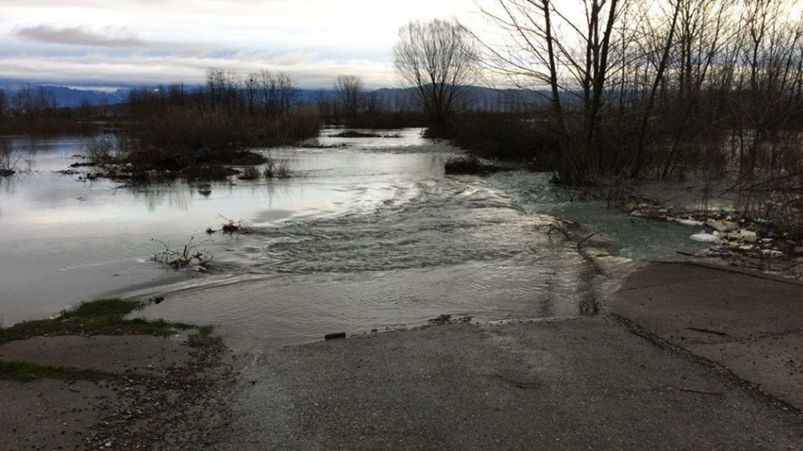
Road infrastructure vulnerability on climate change
Almost 5,000 households have suffered flood damage in Albania since torrential rainfall in December 2017.
Around 600 families are still homeless after being forced to evacuate.
Over 100 road sections and dozens of bridges have been damaged, along with infrastructure such as power and water supply stations.
In the latest assessment, an area of around 15,000 hectares was under water
Albania

Slide 7
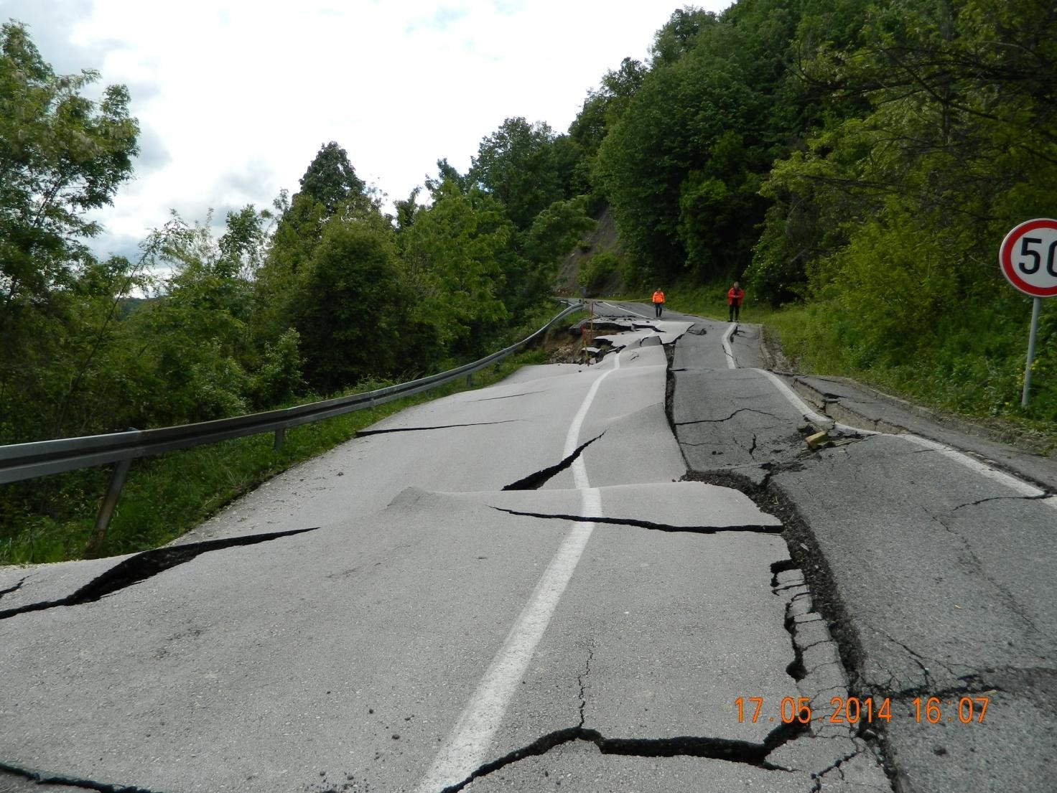
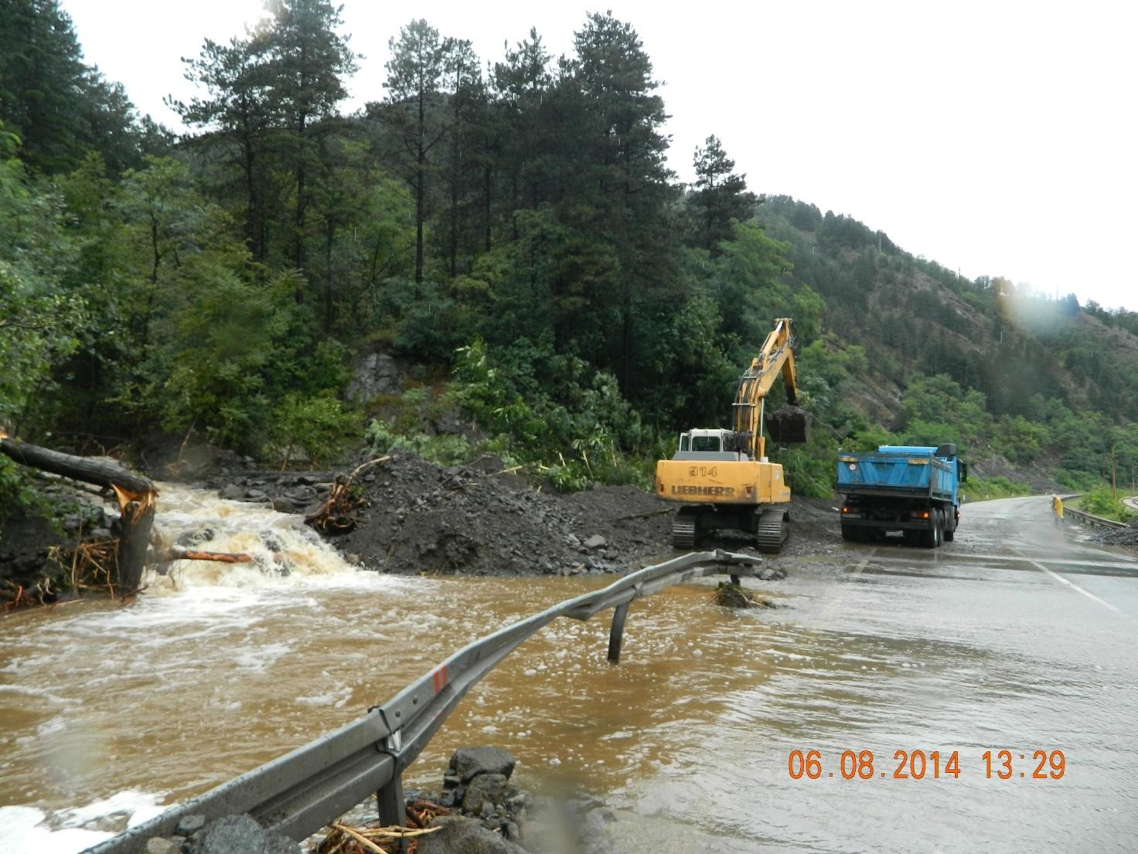
Bosnia and Herzegovina
Floods in BiH represent more than 50% of the frequency of internationally reported hazard losses between 1990 and 2014, followed by extreme temperatures and droughts. Similarly, floods caused 62.2% of the mortality cases and 63.7% of economic losses within the same time. In fact, the average annual loss by floods in BiH was around 55 million USD

Slide 8
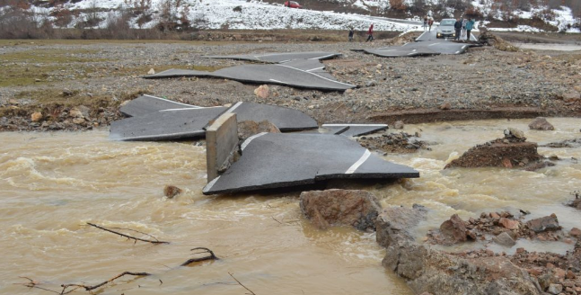
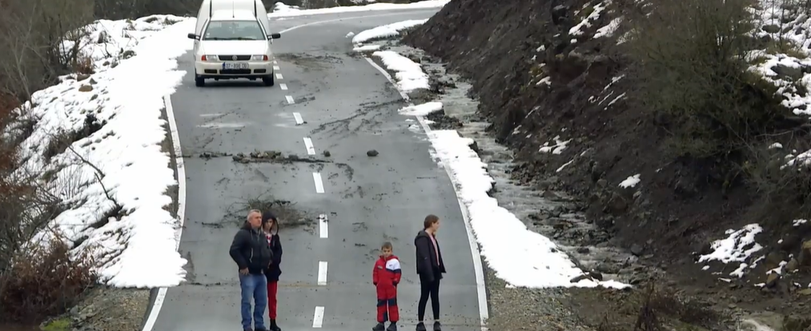
Kosovo*
Kosovo had experienced a 100-year return period flood event in 2015, the affected GDP was estimated about $200 million.
The annual average population affected by earthquakes in Kosovo is about 30,000 and the annual average affected GDP about $90 million.
(Source WB)

Slide 9
Montengero
The economic damages after 1979 earthquake totaled approximately 10% GPD of what was then then the Federal Republic of Yugoslavia, representing around 4 billion euros in today’s values. The knock-on effects on transport, healthcare and schools was severe. The roads and railways were heavily hit, with almost 550 km of major and regional roads in the country requiring repair. The earthquake also had a major impact on social services, healthcare and schools. 240 school facilities were damaged and 53 health services were impacted.

Slide 10
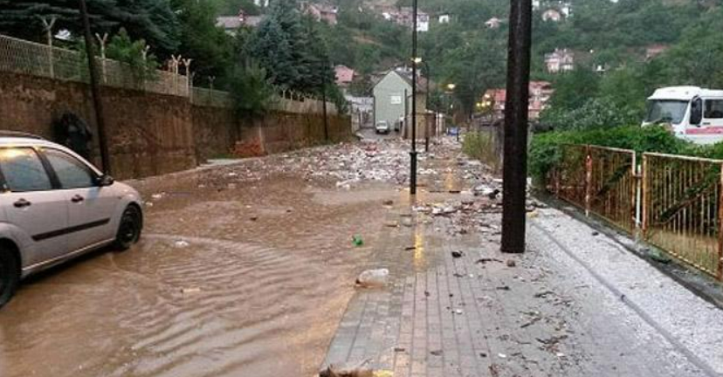
N. Macedonia
# | Year | Disaster type | Date | Total deaths | Population affected | Total damages (‘000 $)
1 | 1995 | Flood | 07.1995 | / | 1,500 | 245,000
2 | 2000 | Wildfires | 08.2000 | / | / | 13,563
3 | 2001 | Extreme temperatures | 1.12.2001 | 15 | / | /
4 | 2003 | Flood | 8.1.2003 | 2 | 4,000 | /
5 | 2004 | Extreme temperatures | 1.7.2004 | 15 | / | /
6 | 2004 | Flood | 4.6.2004 | / | 100,000 | 5.661
7 | 2005 | Storms | 1.1.2005 | 1 | / | /
8 | 2005 | Flood | 4.8.2005 |  | 2,000 | /
9 | 2007 | Wildfires | 07.2007 | 1 | 1,000,000
10 | 2008 | Flood | 4.12.2008 | 2 | 30,000 | 4,842
11 | 2012 | Extreme temperatures | 1.1.2012 | 1 | 5,100 | /
12 | 2012 | Wildfire | 23.07.2012 | 4
13 | 2013 | Flood | 24.2.2013 | 1 | 4,911 | /
14 | 2014 | Extreme temperatures | 28.12.2014 | / | 8,800 | /
15 | 2015 | Flood | 01/03.2015 | 2 | 100,000 | 40,421
16 | 2015 | Flood | 3.8.2015 | 7 | 2,116 | 87,000
17 | 2016 | Flood | 6.8.2016 | 22 | 33,582 | 50,000
18 | 2016 | Earthquake | 11.9.2016 | / | / | 10,000
19 | 2017 | Extreme temperatures | 5.1.2017 | 5 | 2,220 | /
20 | 2021 | Wildfires | 06/09.2021 | / | / | 42,653
The Skopje 2016 Flash Floods resulted in significant damage to 92 km of roads (0.65% of the total national road network).
The damage and losses in the transport sector were estimated to be MKD 732.3 million, out of which 99.5% cost were due to damages to the physical infrastructure

Slide 11
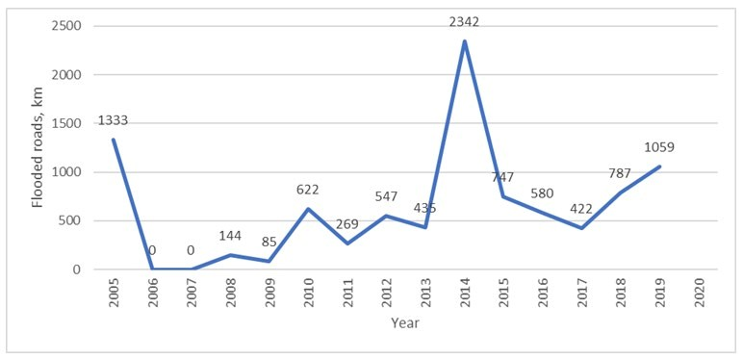
Serbia
25% of the territory is at risk of landfalls and landslides,
35% of the territory is exposed to soil erosion . about 4000 km of roads are exposed to the danger of floods
 | construction needs |  | Million RSD
Reconstruction of selected primary road sections (incl. bridges and culverts) 2,721.2
Reconstruction of selected secondary road sections (incl. bridges and culverts) 3,533.5
Reconstruction of selected local road sections (incl. bridges and culverts) 3,940.7
Reconstruction of selected railway sections (incl. bridges and culverts) 4,565.2
Reconstruction of port infrastructure 10.9
Reconstruction of airports and replacement of equipment 59.5
Replacement of destroyed airplanes 76.6
 | Total |  | 14,830.9

Slide 12
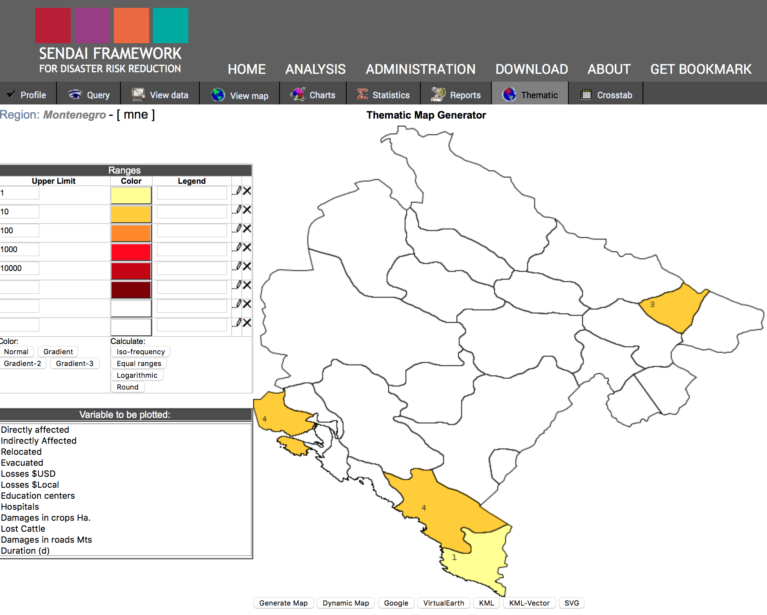
Database on damages from disasters (UNDRR)
The Sendai Framework is the successor instrument to the Hyogo Framework for Action (HFA) 2005-2015: Building the Resilience of Nations and Communities to Disasters.
It is the outcome of stakeholder consultations initiated in March 2012 and inter-governmental negotiations held from July 2014 to March 2015, which were supported by the UNDRR upon the request of the UN General Assembly.
Albania
Kosovo
Montengero
Serbia
https://www.desinventar.net/

Slide 13

Resilience Planning in Road Infrastructure Development
This chapter analyze:
Institutional framework from policy development perspective and relevant data management
Strategies and policies related to resilience planning and road infrastructure development
Hazard risk assessments- data availability
Climate proofing in road infrastructure design- practice

Slide 14
Resilience planning -Institutional framework
Ministries
Environment
Water management
Spatial planning
Transport
Agencies
Road directorates
Environmental agencies
Water Management agencies
Public enterprises
Hydrometeorological and Seismic Institutes
Institutes for Statistics
Insufficient coordination among institutions
Lack of capacities
Insufficient data and information sharing among institutions

Slide 15
Institutional gaps
Weak institutional cooperation of relevant stakeholders
Lack of focus on interdisciplinary approach to enable most effective planning and implementation of climate change adaptation strategy.
Insufficient level of cooperation and coordination of the institutions performing the climate impact assessment with institutions devoted to planning and maintenance of the road infrastructure
Lack of robust internal processes and delegating responsibilities & ownership.

Slide 16
Policy framework
Spatial planning documentation
Transport development strategies
Climate change national adaptation plans
Disaster risk reduction strategies

Slide 17
Type pf policy document | Albania | Bosnia and Herzegovina | Montengero | N. Macedonia | Serbia | Kosovo
Spatial plan | National Territorial Plan of Albania 2030 | No, Only RS entity | Valid until 2020 | Valid until 2020 | Valid until 2035 | Valid until 2020
National transport strategy | National Transport Sector Strategy and its Action Plan 2016 – 2020 | Yes, until 2030 | Strategy for the Development of Transport of Montenegro for the Period 2019–2035 | transport strategy for Macedonia | National Transport Strategy for the period 2022-2030. Under preparation | Strategy of Development for Multimodal Transport for the period 2014-2025
National CC plan | National Climate Change Strategy 2019-? | Climate Change Adaptation and Low Emission Development Strategy of Bosnia and Herzegovina for the period 2020-2030 Nationally Determined Contributions of BiH (NDC) for the period 2020-2030 Third NC | Third National Communication National Strategy on Climate Change 2015-2030 Climate Resilience Strategy and Action Plan for Montenegro 2019 (EBRD) | Enhanced Nationally Determined Contribution Second national communication on CC Long-term Strategy and Law on Climate Action To be drafted | Climate Strategy & Action Plan Republic of Serbia, valid until 2030 | Climate change strategy 2019- 2028
CC Legal framework | Yes, Law on CC | no | Law on Protection against Adverse Impacts of Climate Change 2019 | Law on Climate Action- under preparation EU programme- Preparation of Long-term Strategy and Law on Climate Action | Yes, Law on Climate Change was adopted in March 2021 | no
National CC adaptation plan | yes | In preparation | no | no | no | no
Disaster risk reduction plan | no | No (under development in 10 municipalities) |  | Disaster Risk Reduction (DRR) 2021 – 2025. 5 municipalities ational Platform of the Republic of Macedonia for Disaster Risk Reduction 2010 | Yes, 2018 | Disaster Risk Reduction Strategy and Plan of Action has been developed in 2016 and lasted until 2020.

Slide 18
Policy gaps
Countries are making progress towards Climate change adaptation&mitigation. CC policy documents are mainly focused on mitigation side
BiH does not have spatial plan, while for Kosovo, Montenegro and N. Macedonia is not valid anymore. Valid and available spatial planning documentation does not take into account neither CC risk assessment aspect nor adaptation strategy.
Transport strategies are focusing on improvement of existing transport infrastructure and development of new once, without taking into account CC resilience.
CC adaption plan exist only in Albania, while in BiH is under development

Slide 19
Hazard/risk assessment
Landslide
Flooding
Seismic
Snow fall
High/low temperatures
Wind

Slide 20
Hazard/ risk MAP | Albania | Bosnia and Herzegovina | Montengero | N. Macedonia | Serbia | Kosovo
Landslide | Partially- earthquake-induced landslide hazard at the cross-border region between North Macedonia, Greece and Albania, CRISIS ("Comprehensive RISk assessment of basic services and transport InfraStructure") supported by the Union Civil Protection Mechanism. EU landslide suspectability MAP. ELSUS d base- 170 landslides along Albanian highways over the last three years | Yes, UNDP programme | No, Analysis of flood and landslide risks for Montenegro (with an emphasis on the catchment area of Bojana River and Skadar Lake) FLAT project_Flood and Landslide Assistance and Training, Interreg IPA CBC | Partially- earthquake-induced landslide hazard at the cross-border region between North Macedonia, Greece and Albania, CRISIS ("Comprehensive RISk assessment of basic services and transport InfraStructure") supported by the Union Civil Protection Mechanism. | Yes | No
Flood hazard and flood risks maps | No, EU supported Programme for Improving National Early Warning System and flood prevention in Albania, started at 2021 | Yes, EU programme | Preliminary Flood Risk Assessment is in the proposal phase. EU Climate Resilience Risk Assessment for the main road network in F BiH | No, Assessment of flood risk and economic impact, Drin river basin, Balkans: Albania, Macedonia, Montenegro, Serbia, Kosovo | No, only Flood hazard map for Drin river basin Flood hazard and risk maps for 75 Areas of Potentially Significant Flood Risk (APSFR) previously identified in the Sava, Danube, Morava, Ibar Basins 16% of the territory. Nine studies regarding flood risk analysis for Class I and II roads in river basins in Serbia. | Preliminary Flood Risk Assessment for the River Basins in Kosovo
Seismic (probability map)) | Yes, since 2004 | +, Eurocode 8 | +, Eurocode 8 | +, Eurocode 8 | +, Eurocode 8 | +, Eurocode 8
Snow loads (probability map) | no | +, Eurocode 1 | +, Eurocode 1 | +, Eurocode 1 | +, Eurocode 1,+ Study on a snow accumulation on Class I state roads in 2016 for PE “Roads of Serbia”. The study analyzed about 4800 km of Class I state roads. 678.1 km was exposed to the effect of snow accumulatiton | no
Wind (probability map) | no | +, Eurocode 1 | +, Eurocode 1 | +, Eurocode 1 | +, Eurocode 1 | no
Thermal (probability map) | no | +, Eurocode 1 | +, Eurocode 1 | +, Eurocode 1 | +, Eurocode 1 | no

Slide 21
Hazard/risk assessment implementation gaps
Countries are making progress towards hazard/risk assessment
This is result of EU integration requirements (EU Flood directive+EUROcodes)+ requirements posed by IFI
However, it is not easy to access data/maps, as they are not part of integrated national GIS databases. You can find risk assessment probability maps in different project based or international risk assessment oriented web pages

Slide 22
Risk assessment planning- good practice (Serbia)
Climacor II project- a Study of the impact of climate change on the Road Corridor X . The Study applied a modifed Roadapt/Rimarocc methodology for rapid assessment of the impact of climate change based on an expert survey in terms of the most important threats, possible efects (in terms of availability), and probability of occurrence, and nally defined proposed adapta on measures for individual risks.
The study on the impact of climate change for the City of Belgrade is the only available study that deals with local infrastructure and gives a general overview of the impact on the area of trafic infrastructure in the city.
The Ministry of Environmental Protection made „Report on the Impact of Climate Change on Road Infrastructure with a Proposal for Adaptation Measures“. (UNDP , GCF, 2019-2023, Advancing Medium and Long-term Adaptation Planning In the Republic Of Serbia)

Slide 23
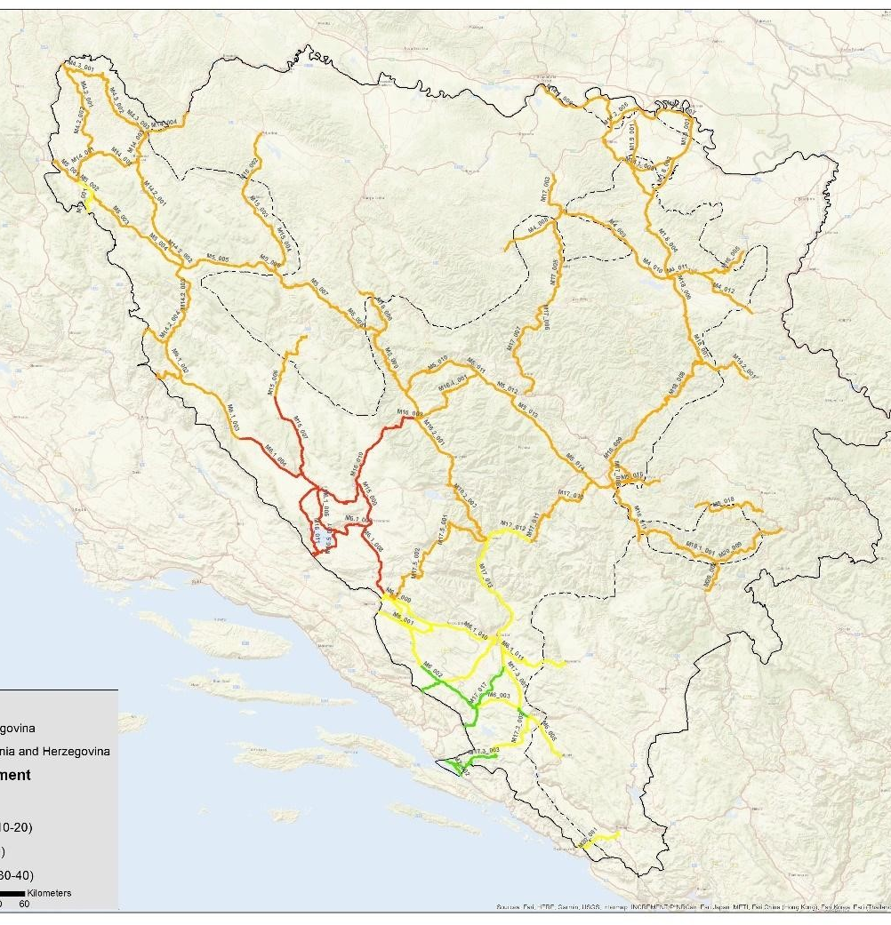
Risk assessment planning- good practice
Climate Resilience Risk Assessment for the main road network in F BiH, EBRD, 2019-2020
Support to establish an necessary collaboration channels and mechanisms for data collection and exchange
Support in assessing climate risks to the road network and mapping specific vulnerabilities (Landslide, flood, wildfire, rockfall, snow cover):
Support the development of an adaptation strategy: Identification of specific risks to the road network and determining most appropriate management options .

Slide 24

Recommendations to increase climate resilience of road infrastructure
Technical aspects
Based on country inputs (by National Consultants)

Slide 25

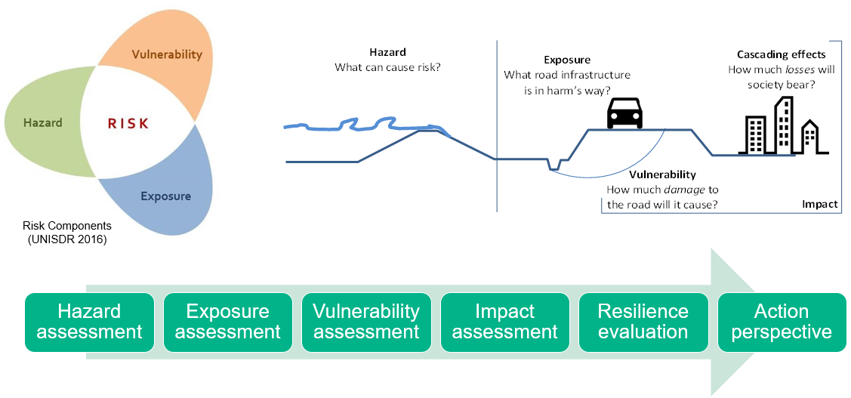
Brief recap of what is needed to build resilience
losses
damages
Achieving an action perspective requires going through a chain of assessments and analyses. This requires data, expertise and (institutional) cooperation.

Slide 26
Most important main aspects that require attention
Building climate reslience requires the implementation of an action perspective.
Implementation
Institutional framework
(Support of) results
Expertise
Analyses
Foundation =
Input data
Let’s make that more specific

Slide 27
Data: climate and weather data (I)
In regional strategies, climate was often described in general terms (averages)
  Climate extremes are most important
  CLIMAPROOF data not always used?
Make use of CLIMAPROOF data
  Should expertise be lacking to understand or implement the CLIMAPROOF or other climate data, then training should be initiated

Slide 28
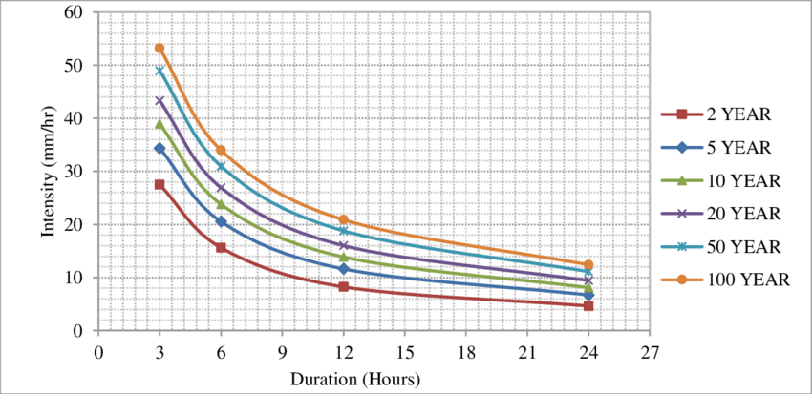
Data: climate and weather (II)
Weather station data often available but quality unclear
In most (all?) cases, speicific meteorological data not present/ available for whole country (e.g. precipitation data such as IDF curves)
  Such data is not only needed for risk analysis but also for improving design procedures
Recommend to start gathering any missing/ incomplete meteorological data
… and making this available

Slide 29
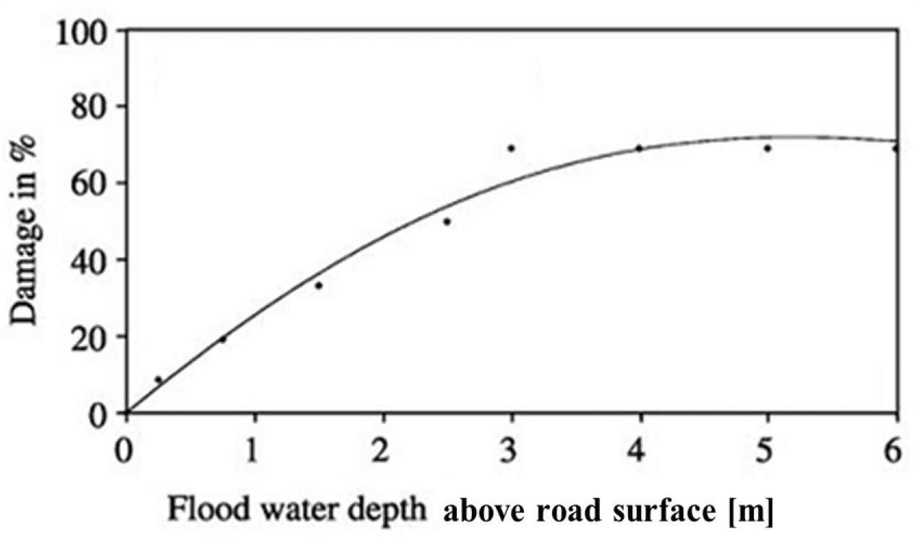
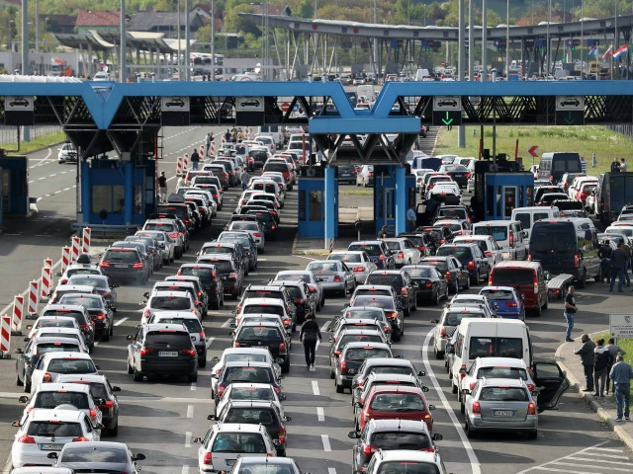
Data: damages & losses
In most countries, historical records of damages to road, caused by hazards are not available.
  This directly impacts the ability to make objective vulnerability curves
Traffic count data not always available
  Sometimes traffic counts are not sufficiently recent
Recommend to start systematically recording the information on effects of hazards at an event level and making this available:
  Construction & repair costs
  Duration of down-time of roads
Perform (new) traffic surveys for those countries where this information is lacking or outdated

Slide 30

Skill & experience for resilience assessments
Only few of previous Resilience assessment reports
Little to no mention on what is an acceptable level of risk (when does action need to be taken?)
  relevant stakeholders often have been identified
Use existing studies
Conduct and/ or evaluate Resilience assessment
  Inventory who can do this?
  Build capacity or find assistance
Define acceptable level of risk together with the relevant stakeholders

Slide 31
Institutional framework
Stakeholder inputs
National consultants
International consultants
Trainings
Webinars
Conferences
Guidelines
Regional Strategy
Capacity Building

Slide 32
Institutional framework
Stakeholder inputs
National consultants
International consultants
Building resilience = team work!
Make data readily available for such assessments
Start systematically collecting any missing data sets (e.g. damages due to events, traffic data, etc)
Improve capacity (expertise) for conducting and evaluating resilience building assessments
Regional Strategy

Slide 33
Overview of recommendations
Data:
  Available and missing data has been listed by National consultants
    Ensure availability of up-to-date, complete, usable and reliable data sets. ‘Sharing is caring’.
    Start systematically collecting data where necessary (link to institutional framework)
Skill and expertise (to conduct and evaluate resilience assessments)
  Identify required expertise to conduct/ evaluate resilience analyses, in- or outside of your country
  Invest in building capacity/ required expertise
Institutional framework:
  Put an institutional framework in place for gathering and sharing required information
    Cooperation between the relevant national agencies is of utmost importance;
  Share the required information (freely)

Slide 34
Final thoughts
With the above in place you get understandable and reliable results. Results that are supported and allow for taking action.
Taking action is what it is all about: building the resilience of the road infrastructure.
By using this approach, improving climate reslience of infrastructure saves money. It is common sense!

Slide 35

Road map for adaptation planning
Objectives of strategic actions

Slide 36

Expected achievements and a timeframe
To make operational institutional cooperation for relevant data collection and risk assessment –
To strengthen institutional capacities for the road infrastructure risk assessment-
To strengthen institutional capacities for resilience planning?
2024 ?
2025 ?
2026 ?

Slide 37
Operational institutional cooperation for relevant data collection and risk assessment
2023-2024
set list of necessary data,
set a hazard/risk assessment methodology
develop missing probability hazard/risk maps and diagrams,
develop cooperation mechanisms among institutions and SOP for data exchange and elaboration =
integrated information system with all data/ hazard/risk maps and diagrams available.

Slide 38
Strengthen institutional capacities for the road infrastructure risk assessment
2023-2025
Prepare
Prepare methodological guidelines/ technical standards on infrastructure risk assessment ,
Deliver
Deliver staff and expert training
Conduct
Conduct climate Resilience Risk Assessment for the main road network in countries missing them

Slide 39
Strengthen institutional capacities for resilience planning and design
2024-2026
Prepare guidelines for mainstreaming climate risks into sectoral policies and programs, EIA, SEA
1
Deliver pilot projects (policy document/ road design)
4
Prepare technical standards for climate risks mainstreaming into a project design
2
Deliver trainings for DM, road and environmental agencies staff, national experts
3

Slide 40
EU Technical guidelines
Refer to guidelines when preparing guidelines for climate risk mainstreaming into policies, EIA, SEA as well as to national technical standards for preparing technical standards for resilient road design

Slide 41
We are open for your comments/suggestions/ amandments
Objectives?
Time frame?
Actions?
is there anything missing?

Slide 42
Thank you for your attention !
Prof. Sanda Midžić Kurtagić,
Center for Environment, Energy and Resources- CENER 21
Mike Woning, Deltares

