Slide 1




Guidelines on Best Practices for Financing Climate Proofing Measures
By Jeroen Trimpe Burger, Infrastructure Finance Advisor at RebelGroup
Partnering with CENER21 and Deltares

Slide 2
CONTENT OF THE GUIDELINES
Introduction
Financing climate proofing in the Western Balkans region
International funding sources available for Western Balkan countries
Financial sources for climate proofing measures for infrastructure projects (roads) for Western Balkan countries
Key issues and challenges
Paving the way to the establishment of a fundraising mechanism in the Western Balkans

Slide 3
1. INTRODUCTION

Slide 4
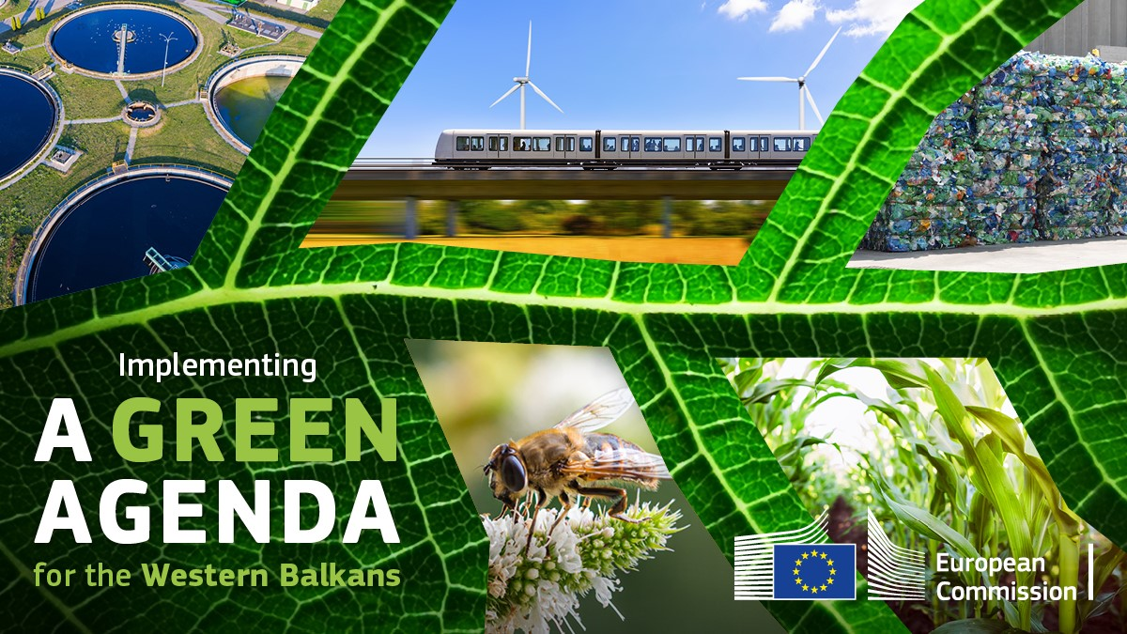
Introduction
The Guideline is targeting relevant stakeholders in the Western Balkans (governments, authorities, private sector, research institutes, universities, CSOs, NGOs) and aimed at increasing their interest and knowledge on financing possibilities for climate proofing of infrastructure
The document is expected to contribute to the implementation of the Green Agenda for the Western Balkans, as well as the implementation of the EU and UN goals and policies in the field of climate action and sustainable development

Slide 5
Introduction
The purpose of this Guideline is to provide an inventory and review of possibilities and practices for financing climate proofing measures, which are applicable to the countries of the Western Balkans.
The main take-aways or conclusions for the readers of this Guideline is the overview of eligibility criteria for available finance instruments for climate proofing measures for roads (re)construction.
The Guideline also provides further food for thought with a summary of possibilities for establishment of a regional fund-raising mechanism for climate proofing of investments in road infrastructure in the Western Balkans.

Slide 6
2. FINANCING CLIMATE PROOFING IN THE WESTERN BALKANS REGION

Slide 7
Financing climate proofing in the Western Balkans Region
A quick run through the different concepts used
  Grants: a sum of money that is targeted towards and provided for climate change activities but does not need to be repaid by the receiver.
  Concessional loans: loans given for the purpose of addressing climate change, which are characterized with longer repayment terms and lower interest rates.
  Non-concessional loans: loans that are provided at a market-based interest rate for climate change activities.
  Equity: investment in projects forming a stake in a business or company (for example in an infrastructure project)
  Guarantees (or development guarantees): Legally binding agreements in which the guarantor agrees to pay (a part of) the amount due on a loan, equity or other instrument in the event of non-payment by the obligor or loss of value in case of investment.

Slide 8
Financing climate proofing in the Western Balkans Region
Overview of financing climate proofing in Western Balkans
  This chapter provides a summary of the current situation in the field of financing measures for climate proofing and resilience in the Western Balkans, based on inputs by individual countries.
  It describes the available economic instruments (fees and taxes) and funds (environmental protection fund, economic development funds, infrastructure development funds, etc.) for financing climate change proofing measures used in each of 6 coutries.
  The Western Balkans have been shown to be vulnerable to extreme weather events, particularly:
    Landslides and unstable slopes along highways, main roads and railways;
    transport infrastructure in the vicinity of river flows which can be affected by floods;
    Rising groundwater levels;
    Floods in spring and summer and snowdrifts in winter periods.

Slide 9
Financing climate proofing in the Western Balkans Region
Examples from individual countries
  The analysis of the situation in the six individual countries of the Western Balkans provides context on financing climate proofing in the region. For example:
    Albania is currently implementing a total of 5 TEN-T projects in their country, with a combined value of 479 million EUR (264 million EUR on the Core Network and 215 million EUR on the Comprehensive Network).
    An eco-tax was introduced to be paid by all natural and legal persons to use road motor vehicles and their auxiliary vehicles on the territory of Montenegro, but there are also environmental taxes for polluters.
    The Draft Law on Climate Change in Serbia prescribes the development of the National Adaptation Plan, including Financial resources needs for priority measures (only first draft is available).

Slide 10
3. INTERNATIONAL FUNDING SOURCES AVAILABLE

Slide 11
International funding sources available for Western Balkan Countries
Bilateral climate change funding
  Federal Ministry for Economic Cooperation and Development (BMZ)
  German Development Agency (GIZ)
  International Climate Initiative (IKI)
  Swedish International Development Agency (Sida)
  International Climate Fund (ICF)
  United States Agency for International Development (USAID)
  Abu Dhabi Fund for Development (ADFD)
  Swiss Investment Fund for Emerging Markets (SIFEM)

Slide 12
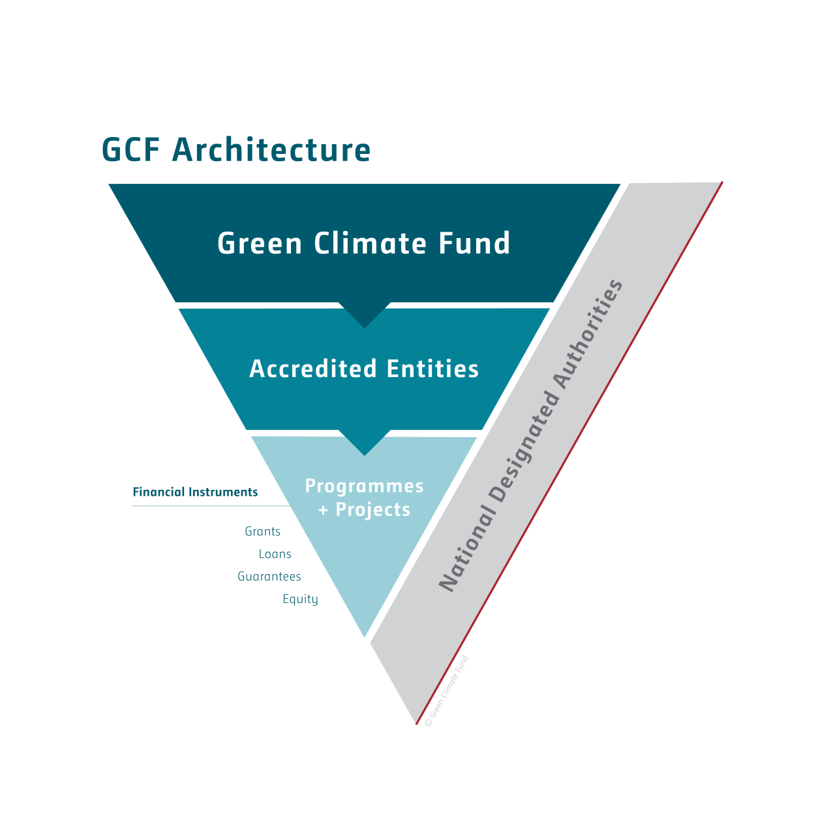
International funding sources available for Western Balkan Countries
Multilateral climate change funding is provided by multilateral financial institutions such as: multilateral development banks (MDBs) and other multilateral financial institutions.
MDBs such as:
  World Bank (WB)
  European Bank for Reconstruction and Development (EBRD)
  European Investment Bank (EIB) and
  Central European Bank (CEB)
  Multilateral climate funds
  United Nations Environment Programme (UNEP)
  Green Climate Fund (GCF)
  Global Environment Facility (GEF)

Slide 13
4. FINANCIAL SOURCES FOR CLIMATE PROOFING MEASURES IN THE WESTERN BALKANS

Slide 14
International funding sources available for Western Balkan Countries
EU programs
EU support to Western Balkan countries is reflected through its financial institutions (European Investment Bank (EIB), European Investment Fund (EIF)) and various programs implemented within all the western Balkan countries, which can be divided into two categories:
  Direct support at national level
  EU assistance at multilateral level.
EU assistance at multilateral level is organized through the Instrument for Pre-accession Assistance (IPA) for Western Balkan countries. IPA dedicated fund weights up to EUR 9 billion (IPA III 2021-2027) distributed among programs:
  Interreg cross-border cooperation program
  Interreg transnational cooperation program
  Interreg program of interregional cooperation
  Interreg-IPA cross-border cooperation program
  ENPI / ENI cross-border cooperation program
  IPA-IPA cross-border cooperation program.

Slide 15
Financial sources for climate proofing measures for infrastructure projects (Roads) for WB countries
The European Green Deal has delivered a set of proposals to make the EU's climate, energy, transport and taxation policies fit for reducing net greenhouse gas emissions by at least 55% by 2030, compared to 1990 levels.
Overall, all 6 countries from WB may have funds from the following, joint sources:
  IPA III/ Multi country assistance
  EU programmes of territorial cooperation
  TAIEX is the Technical Assistance and Information Exchange instrument of the European Union
  Local Administration Facility (LAF) is a programme under the TAIEX instrument managed by the Directorate-General Enlargement of the European Commission.
  Montenegro, Northern Macedonia and Serbia, as part of the Instrument for Pre-Accession Assistance (IPA), which supports reforms in countries in the process of joining the EU, the Instrument for Pre-Accession Assistance for Rural Development (IPARD) focuses on rural areas and the agri-food sector of those countries.

Slide 16

Western Balkans Investment Framework
WBIF is the main vehicle for implementation of the EU’s Economic and Investment Plan for the Western Balkans (providing grants and acting as platform for access to European financing)
One of their key priorities for the next years is sustainable transport WBIF’s Expert Working Group on Green Agenda is evidence of recent prioritization of climate adaptation for WBIF - considering for example the EC Technical Guidance on the Climate Proofing of Infrastructure.
When preparing applications, applicants should take into consideration project’s relevance to the implementation of the following regional and national policies and strategies such as:
  Connectivity Agenda, which recognizes that well-developed and interconnected infrastructure for transport and energy is a key driver for economic growth and jobs as well as for attracting new investments in the region.
  Southeast Europe 2020 strategy;
  EU Strategy for the Danube Region;
  National development plans and country strategy papers.

Slide 17
5. KEY ISSUES AND CHALLENGES

Slide 18
Key issues and challenges
Environmental and climate change management in the Western Balkans is hampered by institutional, political and legal frameworks that are not the optimal.
Some problems common to all Western Balkan countries are: underdeveloped institutions, low civil service capacities, and a weak judiciary.
Concerns about the influence of outside actors in the Western Balkans (Rusia, China etc.)
Key recommendations for the Western Balkans

Slide 19
6. ESTABLISHMENT OF A FUNDRAISING MECHANISM

Slide 20
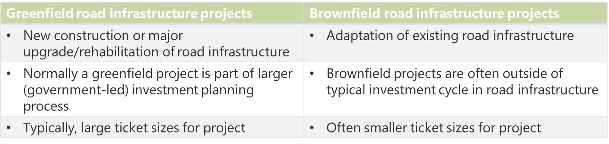
Paving the way to the establishment of a fundraising mechanism in the Western Balkans
Need for financing of climateproof road infrastructure
Greenfield projects are not a challenge in terms of financing: climate proofing constitutes only a couple of percentage point of total project cost and can be financed along with entire project (part of requirements of EIB, EBRD, etc.)
Brownfield projects may be a different story, as these are relatively small and dispersed investments typically not included in large greenfield projects.
If there is a financing gap for these brownfield climate proofing projects, project development is needed, and a dedicated facility might make sense.

Slide 21
Paving the way to the establishment of a fundraising mechanism in the Western Balkans
The advantages of setting-up a separate financing mechanism
Allows for specialized mechanism that centralizes expertise on financing aspects underlying climate-proofing of road infrastructure
Provides a dedicated access point and incentive for developers (and governments) to include climate-proofing in their infrastructure project
Can facilitate dedication of specific TA (project preparation) and grant resources to climate-proofing interventions

Slide 22
Paving the way to the establishment of a fundraising mechanism in the Western Balkans
Disadvantages of setting-up a separate financing mechanism
Limited additionality compared to existing facilities in Western Balkans
Requires additional resources and new and/or a change in governance structure (including obtaining political mandate)
Limited scope in short-run for private sector investment in climate-proofing of road infrastructure (and thus for potential participation/contribution in separate mechanism)
Limited use of economies of scale

Slide 23
Conclusions and reflections
Will the establishment of a separate financing mechanism for ClimaProof investments increase the likelihood of accessing additional resources?
Financing for climate adaptation components of greenfield projects is likely to be covered by existing standards for new investments of financiers (such as EBRD, EIB, etc.)
Climate adaptation for the infrastructure of brownfield projects might require additional financing efforts / resources and justify establishment of a facility
Establishing a new and separate financing mechanism would however offer limited additionality compared to existing facilities in Western Balkans and requires additional resources and new and/or a change in governance structure (including obtaining political mandate)
So, what are the options going forward?

Slide 24
Conclusions and reflections
Recommendations and next steps
Address the capacity gap – strengthen project development capacity in the region through dedicated TA in order to develop a project pipeline and attract potential financiers
Consider the option of pooling and packaging the investments needed for different ClimaProof interventions in the six Western Balkan countries to ensure sufficient scale for potential financiers.
Explore the creation of an add-on facility* within the WBIF (or other potential financiers such as GCF) for climate proofing of existing road infrastructure – which would provide access to (concessional) finance and technical assistance programs for packages of projects in Western Balkan region.
*with financing coming from the host fund, the add-on facility could take the form of a dedicated project development and preparation facility, preparing projects for investment by existing financing windows (for example WBIF or GCF)

Slide 25
Thank you!
Feel free to reach out to me with any questions on jeroen.trimpeburger@rebelgroup.com

Slide 26

Overview of financing climate proofing in Western Balkan
Albania
The Ministry of Finance developed a Guideline on the preparation of the Mid-Term Budget Program 2018-2020 that addressed cross-sectoral issues related to climate change resulting from the ratification of the Paris Agreement
The National Adaptation Plan (NAP) was drafted by GIZ as a stand-alone document in the form of a Climate Adaptation Strategy (CAS)
Albania has not adopted a National Adaptation Strategy on climate that stands as a separate document.
Implementing policies building and strengthening resilience to climate-related and natural hazards would be an important step towards progress.
Environmental taxes are considered as an economic instrument to control pollution and management of natural resources and are designed to influence the behavior of businesses, producers and consumers.
Albania is currently implementing a total of 5TEN-T Projects, with a combined value of 479 million EUR (264 million EUR on the Core Network and 215 million EUR on the Comprehensive Network).

Slide 27
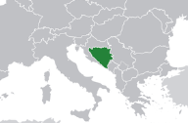
Overview of financing climate proofing in Western Balkan
Bosnia and Herzegovina
Current economic instruments to climate change mitigation and adaptation are mainly focused on taxes and excise duties on fuel, taxes on the use of natural resources and taxes on the use of forests.
The Law on Roads in FBiH, the RS Law on Public Roads and the Law on Roads in BD define rules on management, planning, financing, construction, reconstruction, maintenance and protection of public roads and public-private-partnerships and monitoring in this regard, but climate proofing measures have not yet been integrated.
Bosnia and Herzegovina is currently implementing a total of 20 TEN-T projects, with a combined value of 2.277 billion EUR.
Special environmental fees for air pollution from certain polluters as well as the for the motor vehicles pollution.

Slide 28

Overview of financing climate proofing in Western Balkan
Kosovo*
Strategy for Environment Protection, highlight a lack of finance for environmental issues in general.
One of the specific objectives of the Action Plan is to ensure investment in relevant infrastructure and development of appropriate financial measures as instruments for achievement of Climate Change Strategy goals.
Kosovo* has environmental tax for air pollution which could be used as a source for climate proofing measures for infrastructure projects.
Kosovo* is currently implementing a total of 3 TEN-T projects, with a combined value of 520 million EUR (320 million EUR on the Core Network and 200 million EUR on the Comprehensive Network).
* This designation is without prejudice to positions on status and is in line with UNSCR 1244 and the ICJ Opinion on the Kosovo Declaration of Independence.

Slide 29
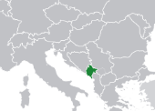
Overview of financing climate proofing in Western Balkan
Montenegro
Montenegro adopted the National Platform for Disaster Risk Reduction in line with the global Hyogo Framework for Action. The Platform has no specific budget, and all activities are financed from the budget of governmental and international organizations through different projects.
Eco-tax was introduced to be paid by all natural and legal persons to use road motor vehicles and their auxiliary vehicles on the territory of Montenegro, but also there are environmental taxes for polluters.
Montenegro is currently implementing a total of 5 TEN-T projects, with a combined value of 1,133.39 million EUR.

Slide 30

Overview of financing climate proofing in Western Balkan
North Macedonia
The responsibilities and tasks of the Ministry of Finance cover the financial, tax and customs aspects in climate action.
The preparation of the new Law on Climate Action and Long-term Strategy on Climate Action (covering Energy and Climate Package 2030 with the perspective 2050) started in February 2019.
Nort Macedonia has environmental tax for air pollution which could be used as a source for climate proofing measures for infrastructure projects.
North Macedonia is currently implementing a total of 8 TEN-T projects with a combined value of 999.31 million EUR (942.71 million EUR on the Core Network and 56.6 million EUR on the Comprehensive Network).

Slide 31
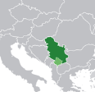
Overview of financing climate proofing in Western Balkan
Serbia
All documents in climate change field have been developed using multilateral and bilateral donations.
The Draft Law on Climate Change prescribes the development of the National Adaptation Plan, including Financial resources needs for priority measures (only first draft is available).
Serbia has environmental tax for air pollution which could be used as a source for climate proofing measures for infrastructure projects.
Serbia is currently implementing a total of 6 TEN-T projects, with a combined value of 2.7 billion EUR (1.349 billion EUR on the Core Network and 1.351 billion EUR on the Comprehensive Network).

Slide 32
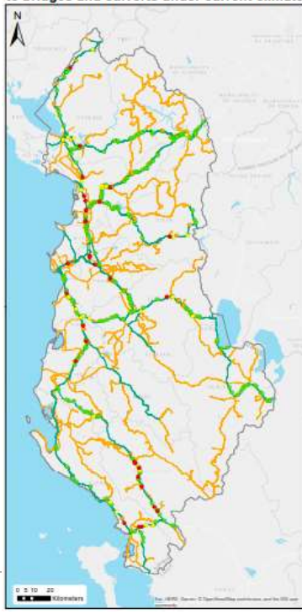
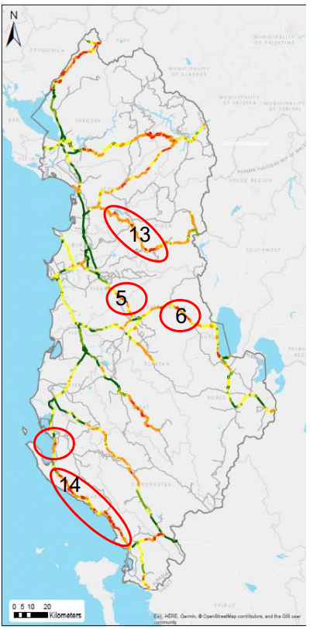
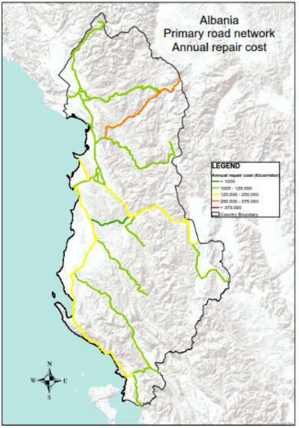
Case studies

