Slide 1
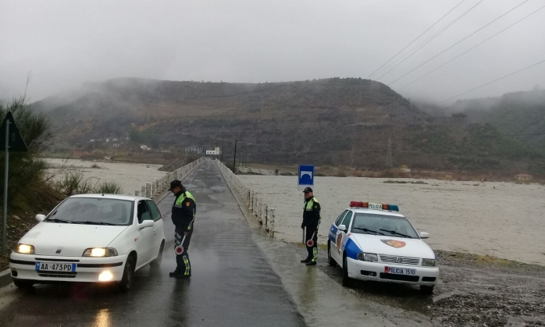
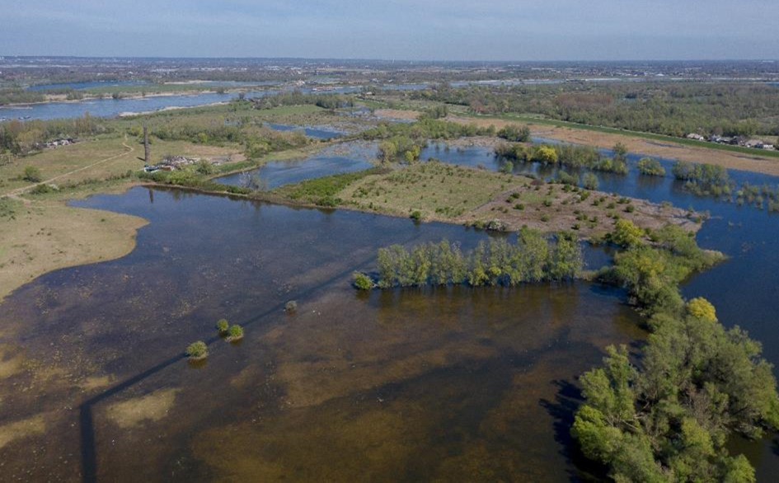
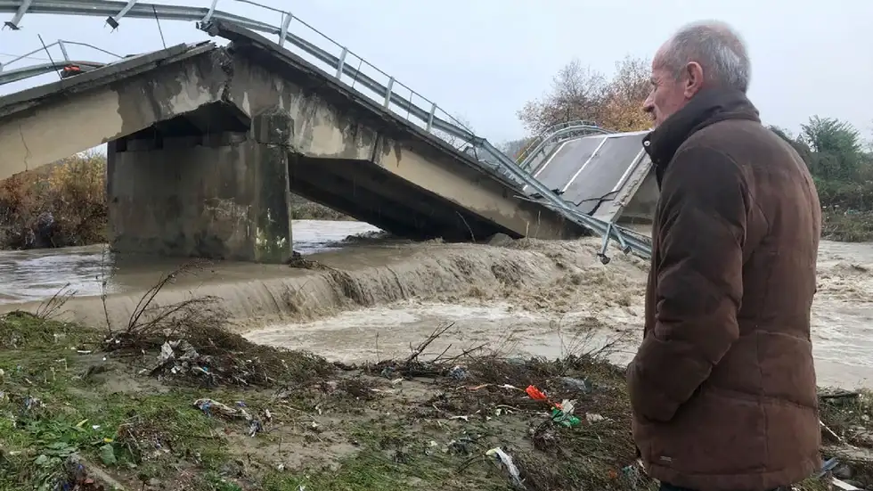
Floods in Albania, December 2017.
Photo: Ministry of Interior, Albania
Re-wetted floodplains of the Rhine river NL
Mamuras, Albania, Dec 2017. (AP Photo/Florent Bajrami)
Nature-based Solutions for Disaster Risk Reduction
Ellis Penning
Foto: Flip Witte

Slide 2
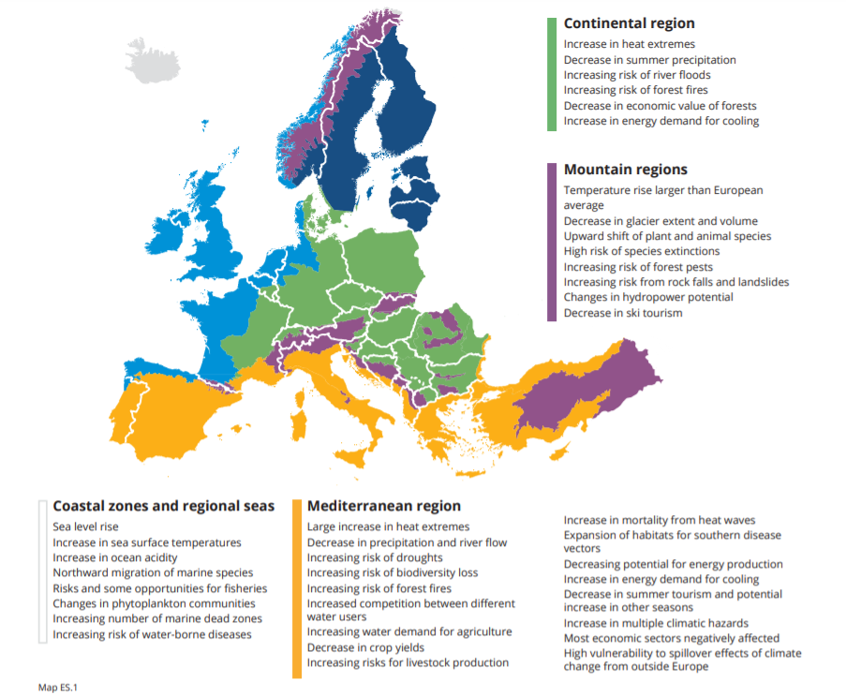
Why NbS for DRR related to infrastructure?
Western Balkans as one of the most vulnerable areas in Europe related to climate change (IPCC, 2021)
Increases in temperature larger than the European average, changes in precipitation patterns, leading to increased flood risk, extended periods of drought, soil erosion and forest fires.
https://www.eea.europa.eu/publications/climate-change-impacts-and-vulnerability-2016/key-findings

Slide 3

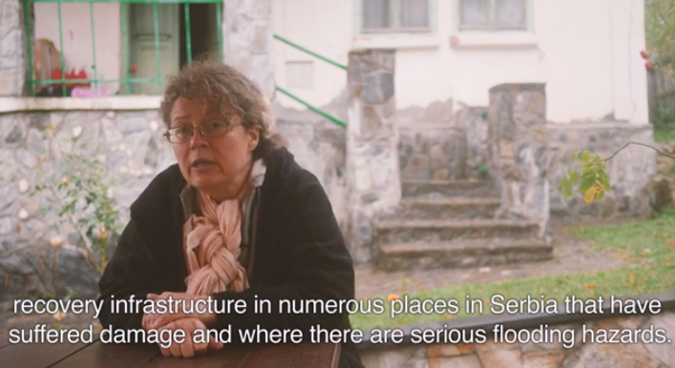
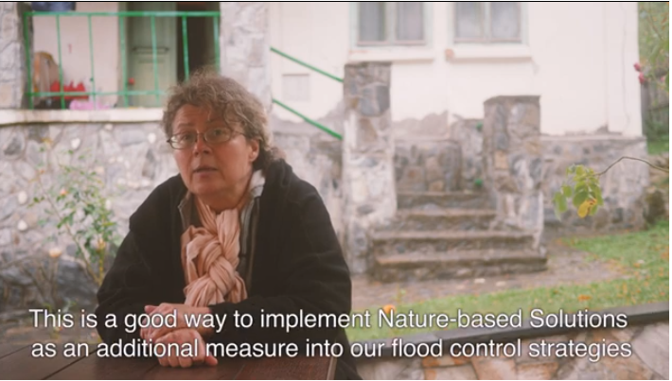
Why NbS for DRR related to infrastructure?
Western Balkans as one of the most vulnerable areas in Europe related to climate change (IPCC, 2021)
Increases in temperature larger than the European average, changes in precipitation patterns, leading to increased flood risk, extended periods of drought, soil erosion and forest fires.
Neda Maletic`
Public investment management office
https://www.iucn.org/regions/eastern-europe-and-central-asia/projects/adapt-nature-based-solutions-western-balkans

Slide 4

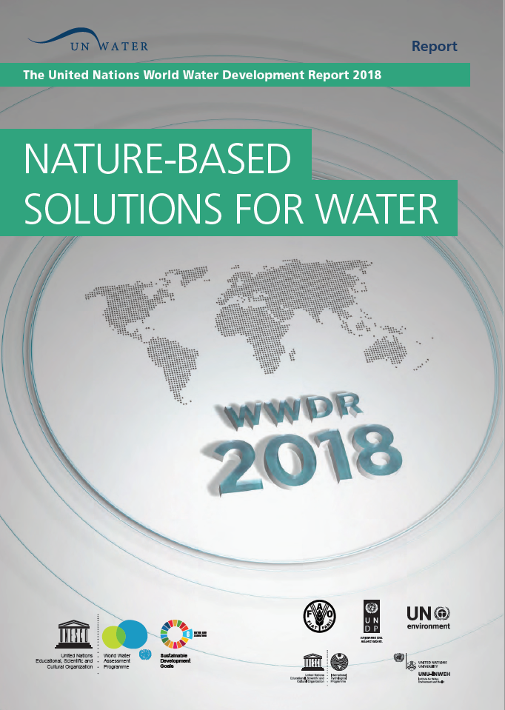
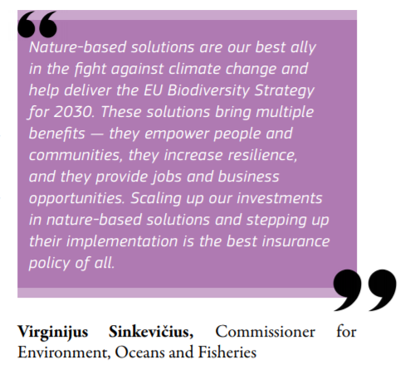
Increasing call for Nature-based Solutions
“…”think about green
before investing in grey.”
EEA Technical Report No 12/2015
“Work with nature rather than against it”

Slide 5
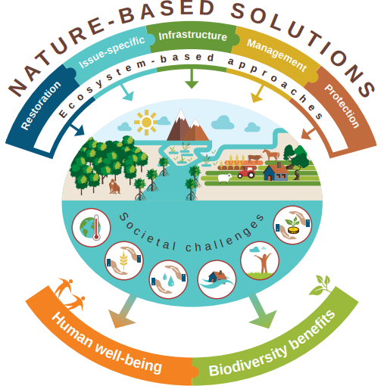
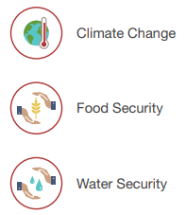
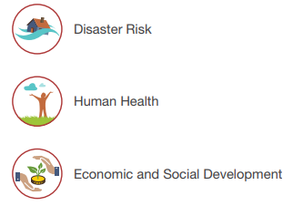
What are Nature-based Solutions?
“actions to protect, sustainably manage, and restore natural or modified ecosystems that address societal challenges effectively and adaptively, simultaneously providing human well-being and biodiversity benefits.”
(Cohen-Shacham et al, 2019).
https://www.iucn.org/theme/nature-based-solutions
https://portals.iucn.org/library/sites/library/files/documents/2016-036.pdf
https://portals.iucn.org/library/sites/library/files/documents/2020-021-En.pdf

Slide 6
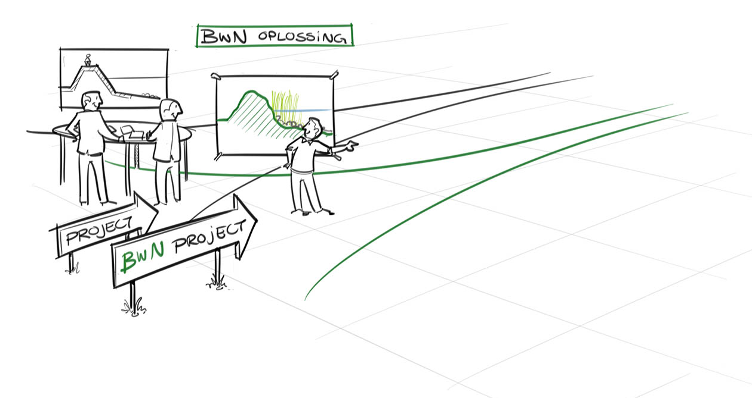

What are NbS
To make proactive use of natural processes, have a nett-positive contribution to biodiversity
‘Building with Nature’, ‘Eco-engineering’, ‘Blue-green infrastructures’….
Tackle water security challenges:
Flood defence
Flood/drought mitigation and adaptation
Environmental pollution
Urban heat stress and climate adaptation
To reduce risks, be adaptive over time
To provide cheaper, better and/or quicker alternatives,
To serve multiple goals
To avoid lock-ins
NbS Solution
Notes:
What are the solutions

Slide 7
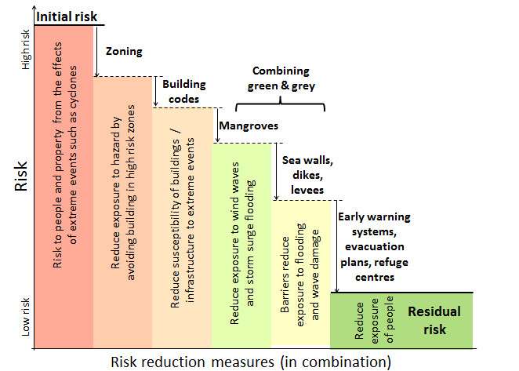
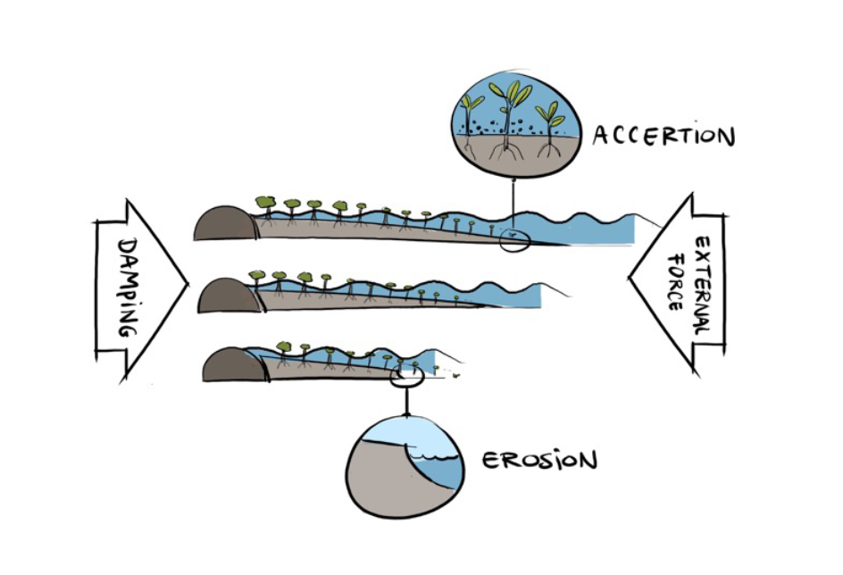
Where do Nature Based Solutions fit?
NBS in combination with other risk reduction measures
Offers good playing field for showing Deltares knowledge to full extent

Slide 8
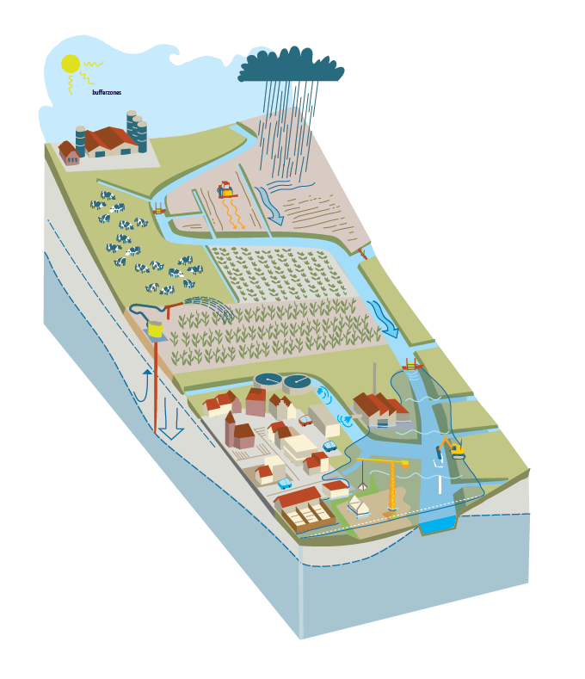
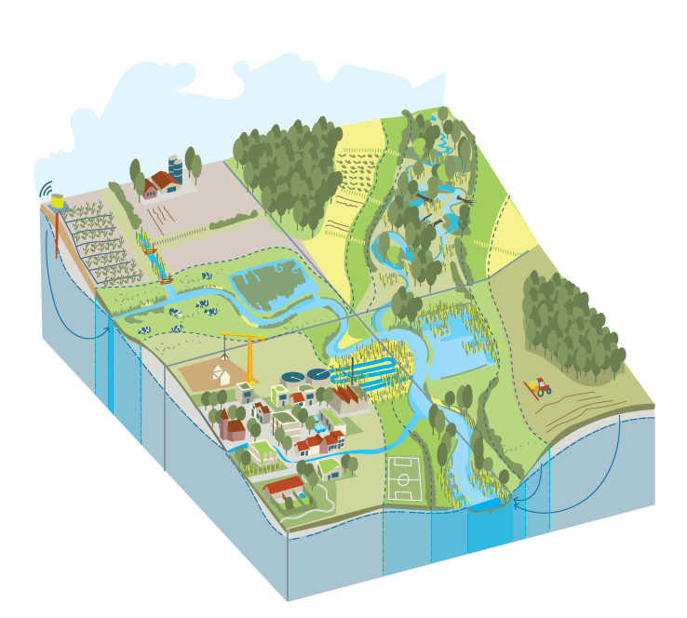

A catchment approach to DRR is needed
Soil erosion
Rapid drainage
Natural functioning
Sustainable agriculture
Groundwater
depletion
Improved water quality
and quantity
Heat stress
Flash floods
Chemical pressures
Hydomorphological pressures
Urban resilience
https://www.stowa.nl/publicaties/praatplaat-klimaatbestendig-beekdallandschap

Slide 9
Improving the hydrograph for flood and drought reduction
Less intense + lower chance of extreme peaks
Current situation
Catchment wide implementation of measures
Rain in mm
Improved base flow
Discharge
time

Slide 10
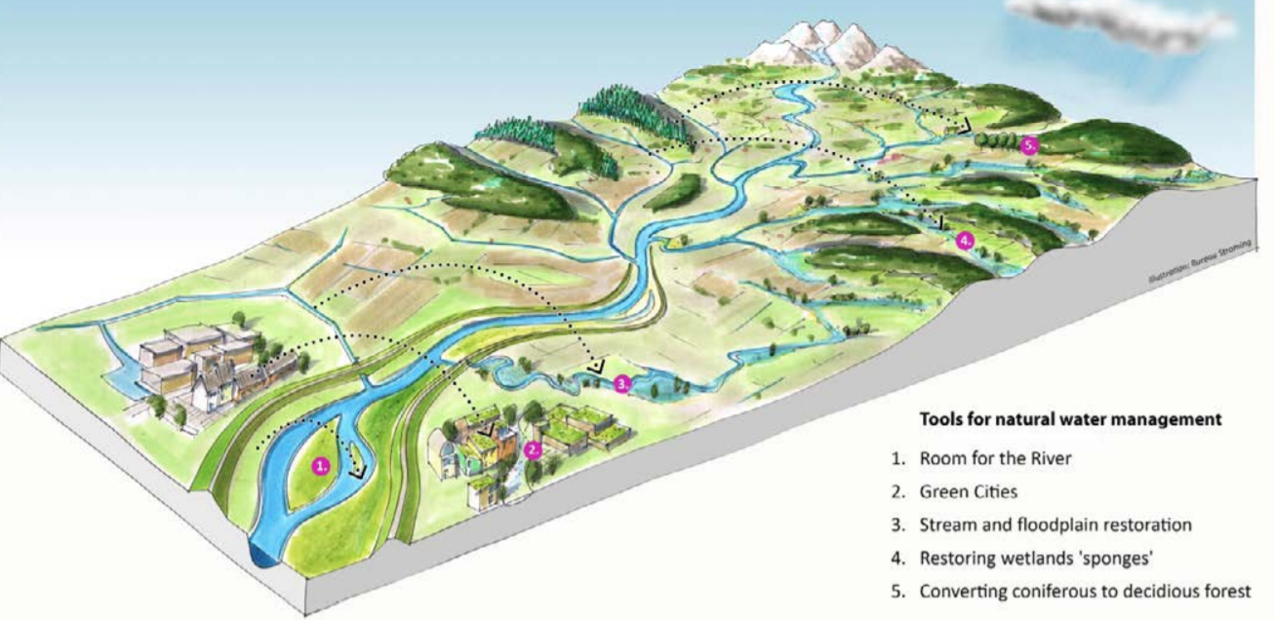
Natural water management
Improve sponge functioning of the catchment
To reduce water-related risks
To reduce floods and droughts
To restore ground water levels
To increase natural resilience
To increase biodiversity values
To increase ecosystem services
Source: https://europe.wetlands.org/publications/sponge-restoration/

Slide 11
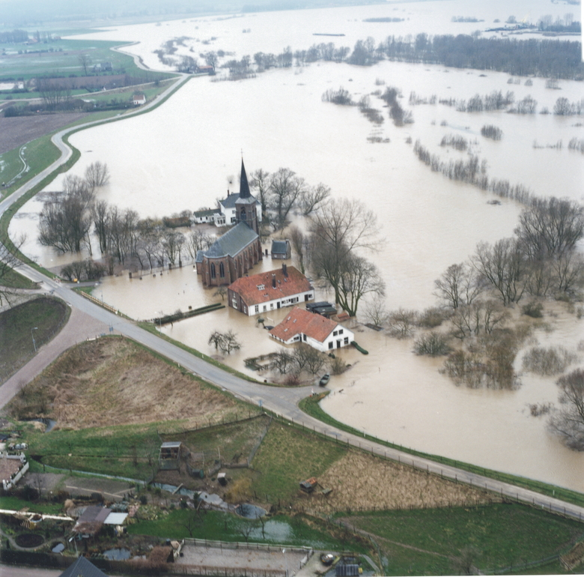
Room for Rivers NL
1993 -> 2018
1993, 1995 Floods.
  Rhine discharge 12,000 m3/s
  250,000 people evacuated
1996 – 2005
  Planning
  Public consultation
2006 – 2018
  Realisation 34 projects
  2,3 billion €
Dual objectives
  Flood protection
  Spatial quality
    Quality of life
    Ecosystem quality (WFD, Natura 2000)
Source: beeldbank Rijkswaterstaat

Slide 12
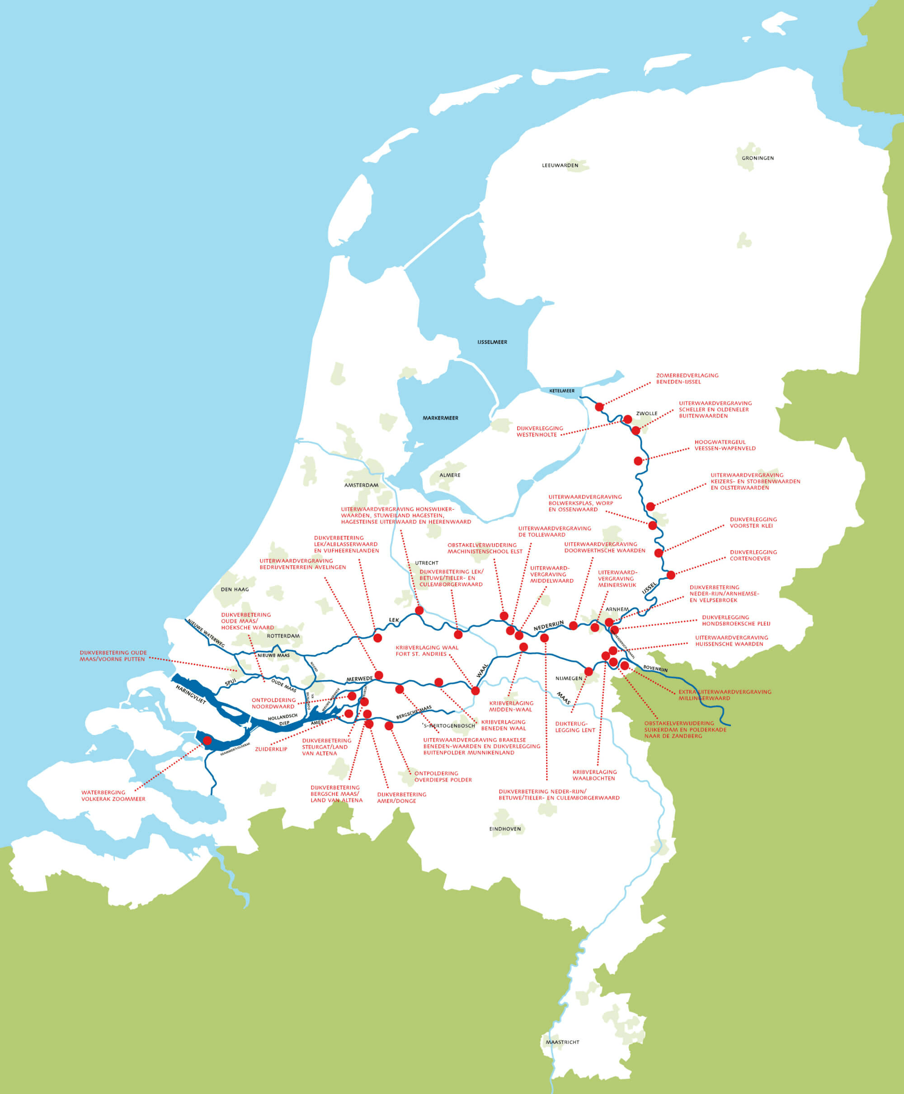
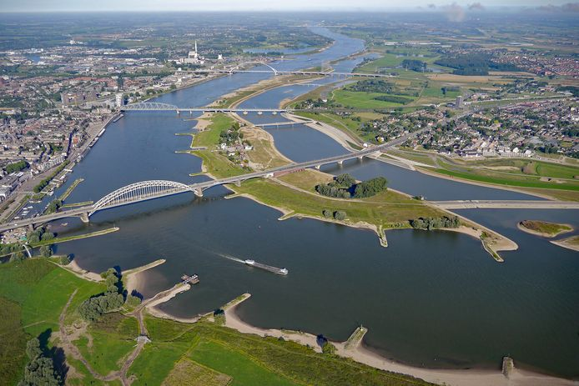
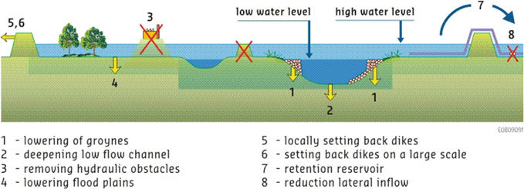
Room for the Rhine branches
Programme of measures
Source Silva, W., Klijn, F. and Dijkman, J.P.M. Room for the Rhine branches in the Netherlands, what the research has taught us.

Slide 13
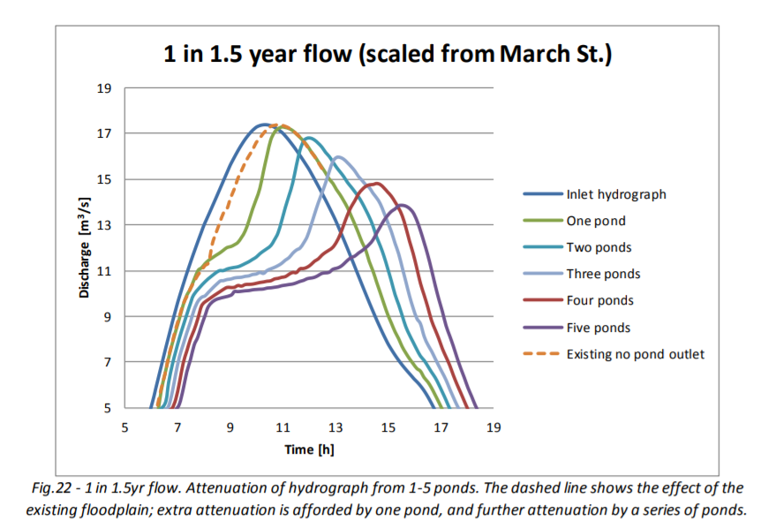
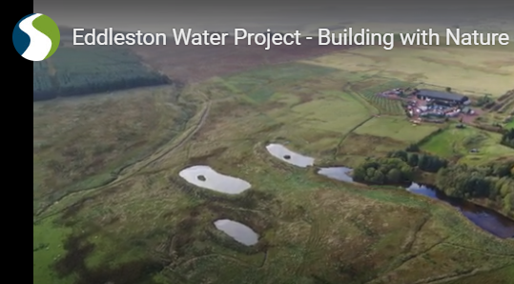

Eddleston Water Project, Scotland
Reducing peakflows and limiting droughts by:
implementing natural water retention ponds upstream
Renaturalisation of streams
Reforestation upstream areas
Succesful because of:
Stakeholder involvement
Co-benefits for local people
Local farmers actively engaged in the
implementation of the measures
Spray (2016) - https://tweedforum.org/eddleston-project-database/
https://tweedforum.org/our-work/projects/the-eddleston-water-project/eddleston-water-project-videos/
Notes:
Cutting carbon emissions by improving the water qualy of lakes and ponds. 5% of dutch emissions are from surface waters.

Slide 14
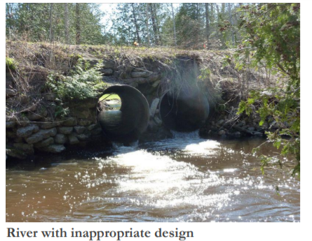
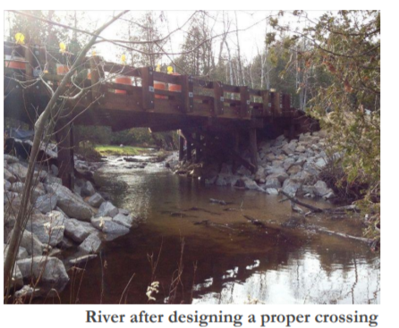
Next to implementing NbS also rethinking current infrastructure designs in line with the river-ecosystem functioning
Analyse locations of bottlenecks, and avoid them in new designs
Source: https://huronpines.org/prc/

Slide 15
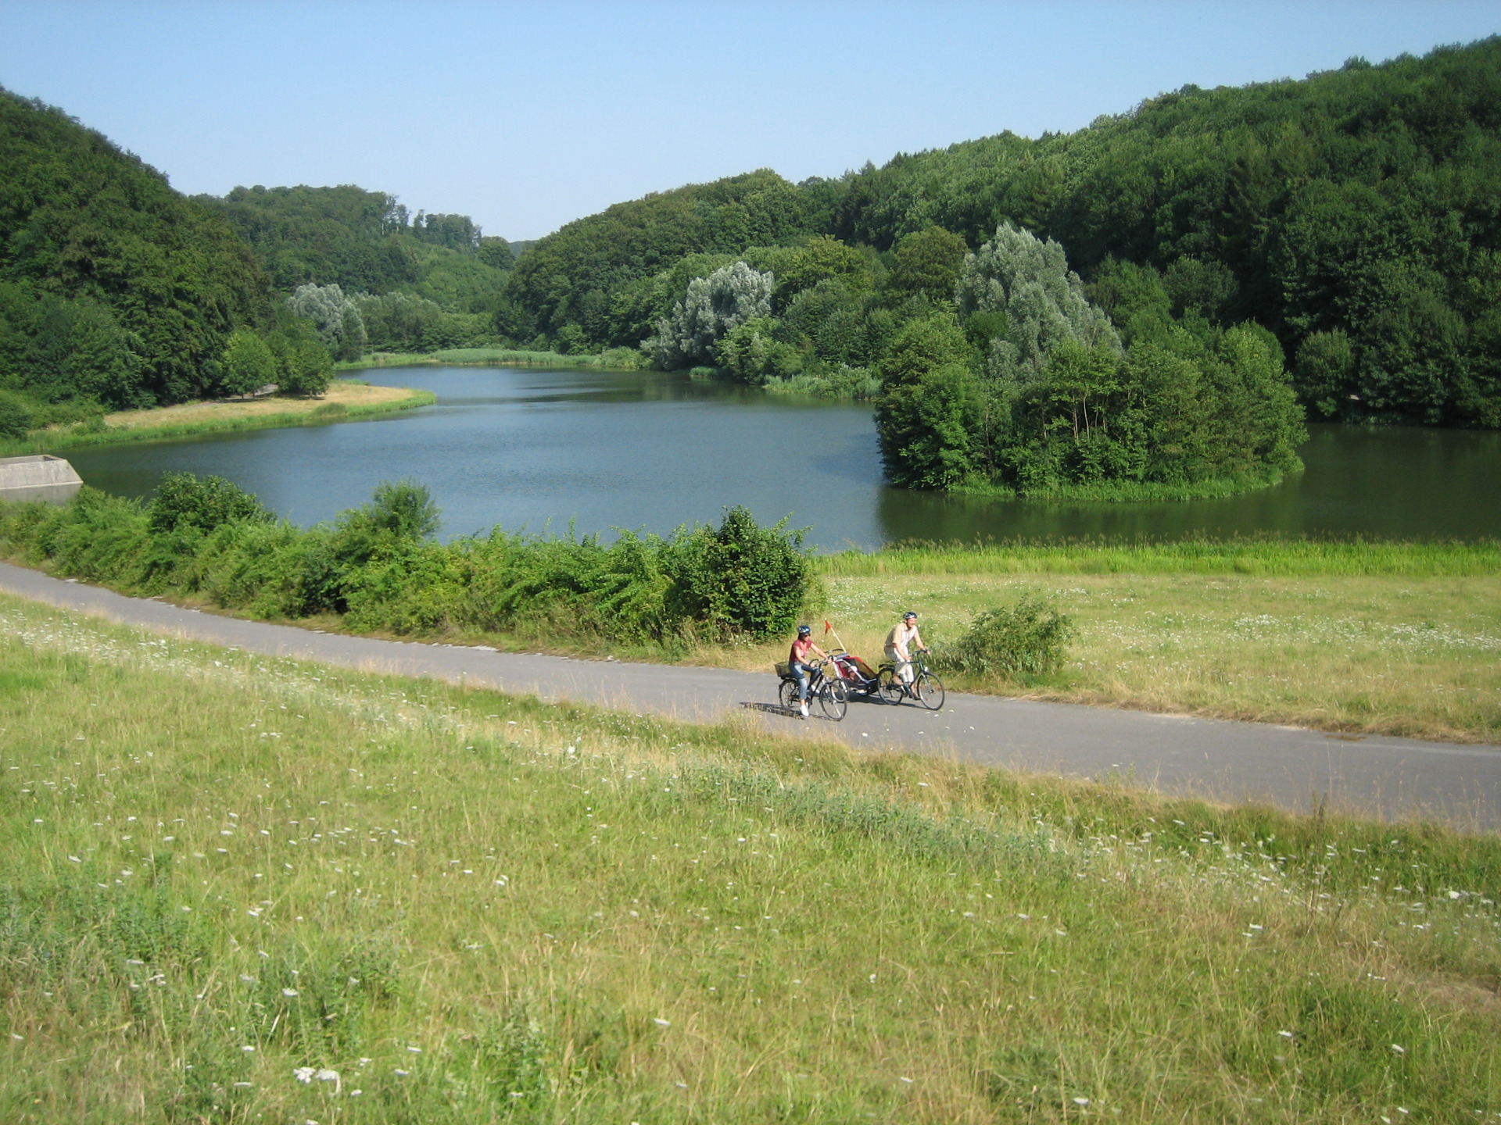
Take home messages
Nature-based Solutions are part of a larger set of measures
NbS often provide multiple benefits for multiple stakeholders
System understanding and a catchment-wide approach is needed
For infrastructure specifically water retention and soil stabilization related NbS can reduce risks
Infrastructure at a given location may benefit from measures taken further upstream
Source: https://www.paderborner-land-route.de/pbl-route-nl/route/3-lichtenau-bad-wuennenberg.php
Water retention basin Lichtenau-Husen

Slide 16
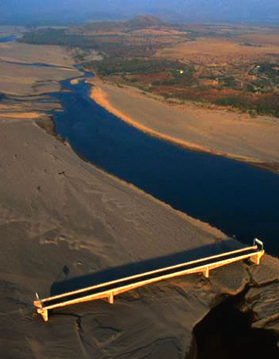
Thank you for your attention!
Ellis.penning@deltares.nl
Foto: Flip Witte
Notes:
Choluteca - Honduras

