Slide 3
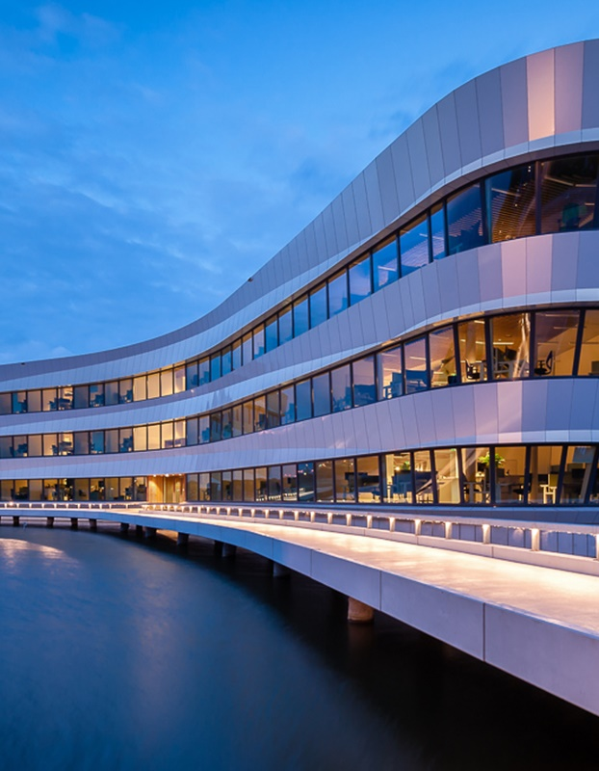
Developing risk and vulnerability assessments
Identifying hotspots and investment preparation for climate proof road assets in the Western Balkans
Mark de Bel
Naam Achternaam

Slide 4
Table of contents
General Methodology
  Risk assessment
  Climate Change
  Damage and losses
Economic analysis of road assets in Albania
  Approach for Landslides
  Vulnerability
  Measures
  Cost Benefit Analysis and Action perspective
Lessons learned

Slide 5
Basic Concepts
Naam Achternaam
Notes:
Primero daré una introducción a lo que son los modelos de circulación global y cómo el modelado climático funciona

Slide 6
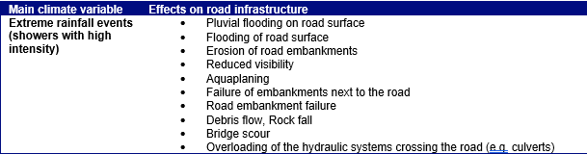
Effects of climate change on infrastructure design
Webinar : Developing risk and vulnerability assessments
In general we know whether precipitation or temperature influences the engineering design.
  For example: More intense rainfall may result in more landslides because saturation of soils on slopes

Slide 7
General Methodology
Naam Achternaam
Notes:
Primero daré una introducción a lo que son los modelos de circulación global y cómo el modelado climático funciona

Slide 8
General Methodology
Webinar : Developing risk and vulnerability assessments
From vulnerability assessment to action perspective
Hazard assessment
Exposure assessment
Vulnerability assessment
Impact assessment
Risk profile
Action perspective

Slide 9



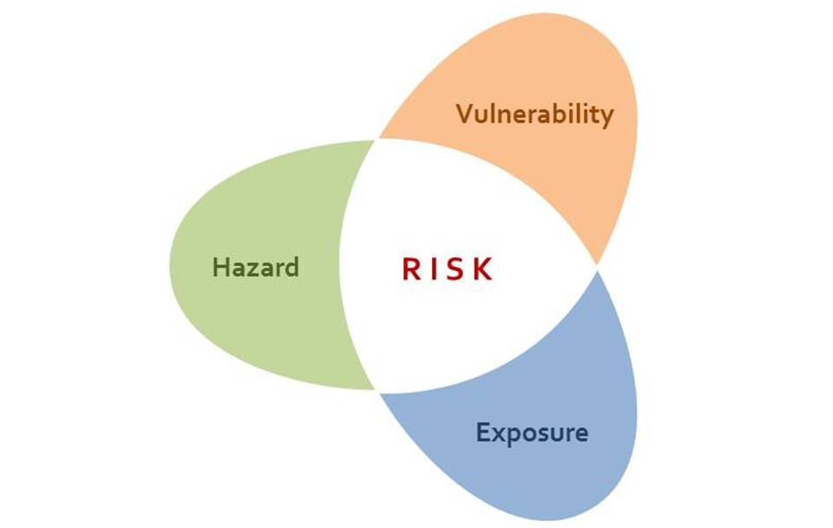
Hazard and vulnerability
Webinar : Developing risk and vulnerability assessments
Hazard assessment
Exposure assessment
Vulnerability assessment
Impact assessment
Risk evaluation
Action perspective
Notes:
Risk Analysis: determine where hazards may affect the roads, how big the impact is and what is the probability
Identify and characterize hazards
Determine exposure based on various Return Periods (RP)
Vulnerability based on damage functions
Losses based on recovery functions
Risk expressed as Expected Annual Damage (EAD) and Expected Annual Losses
2. Action planning: determine where to take measures, which measures to take and formulate action plan
Prioritize locations through combination of criticality and risk
Determine measures (interventions/strategies) and their evaluation
Action plan combines prioritized locations, measures and the interventions in time

Slide 10
Risk profile road network; Damage and Losses
Webinar : Developing risk and vulnerability assessments
Origin
Cost of increased travel time
Damage
  Damage to road assets (repair costs)
Losses
  Vehicle Loss Hours as a result of traffic jams on segment
  Vehicles Loss Hours because of alternative routes
+
Cost of increased travel distance
x
Risk → AED = repair costs + economic losses
Traffic intensity
Hazard assessment
Exposure assessment
Vulnerability assessment
Impact assessment
Risk profile
Action perspective
Total losses
Destination

Slide 11
Considering climate change
Webinar : Developing risk and vulnerability assessments
Impact
Likelihood

Slide 12
Considering climate change
Webinar : Developing risk and vulnerability assessments
Impact
Likelihood

Slide 13



Effects of key uncertainties in external factors
Climate change
Damages
Low-scenario
High-scenario
Traffic
Losses
Low-scenario
High-scenario

Slide 14
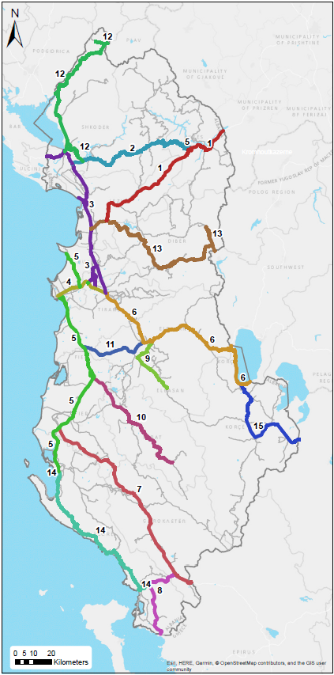
Case study in Albania
Naam Achternaam
Notes:
Primero daré una introducción a lo que son los modelos de circulación global y cómo el modelado climático funciona

Slide 15
Approach – Risk analysis and action planning
Webinar : Developing risk and vulnerability assessments
Risk analysis per hazard
Hazard mapping (example; floods)
Risk analysis → Annual Expected Damages (AED)
Action planning per hazard
Prioritization of locations
Criticality
Identification of measures
Cost effectiveness analysis (selection of measures)
B/C ratio

Slide 16
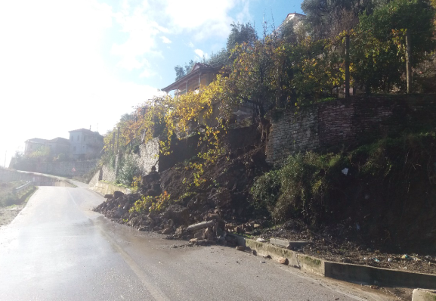
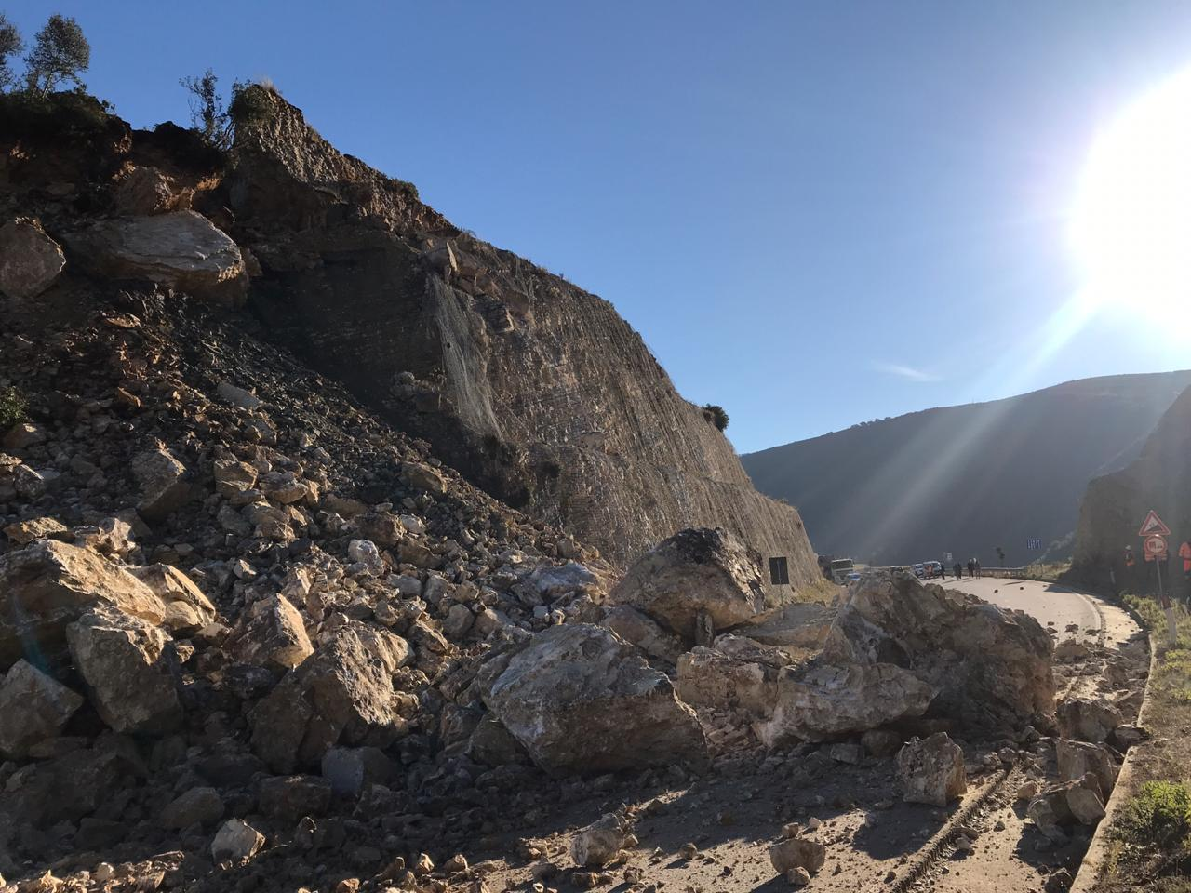
Landslides
Notes:
Landslide; The downward movement of a mass of rock, earth, or artificial fill on a slope, often induced (started) by prolonged or heavy rainfall.

Slide 17
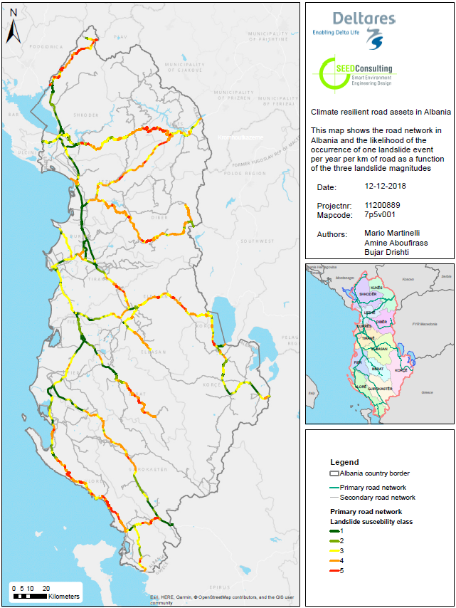
Landslides
Vulnerability
Colours indicate probability of a landslide (Low, High)
Based on:
  Historic events
  Susceptibility map
Indicates location proposed measures

Slide 18
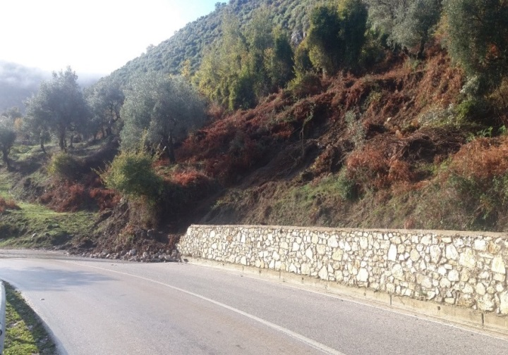
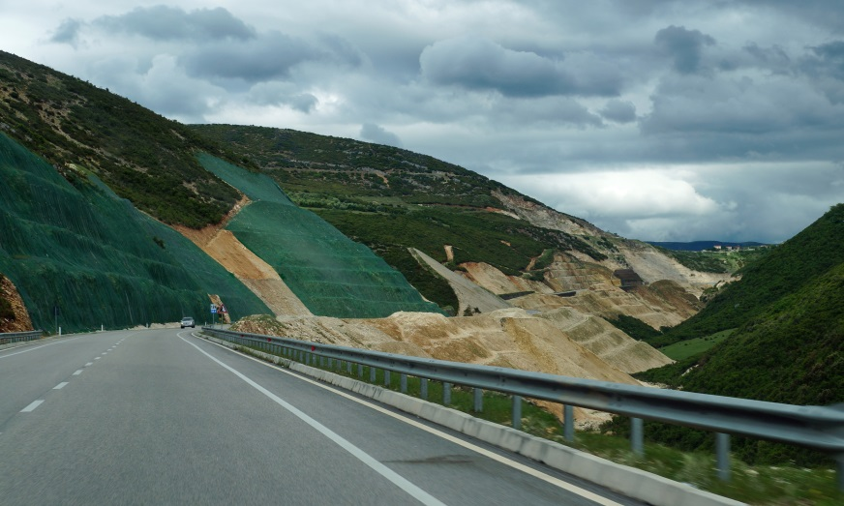
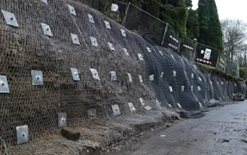
Landslides - Typical measures
Retaining structures e.g. retaining walls, gabion walls
Stepped slope embankments
Internal slope reinforcement e.g. rock bolts
Drainage
Reforestation
(Improved) regular/ preventative maintenance
Better response/ repair plan (i.e. shorter response times)

Slide 19
Landslide - Measures
Proposed measures per corridor, based on:
Vulnerability
Terrain conditions

Slide 20
Landslides - Cost Benefit Analysis
Based on CBA:
Assuming measures will reduce AED by 50 %, over 25 years at 4 % net discount rate as benefit, and a traffic growth of 4 %
Corridors 5 and 6, positive decision on investments
Corridors 13 and 14, negative decision on investments

Slide 21
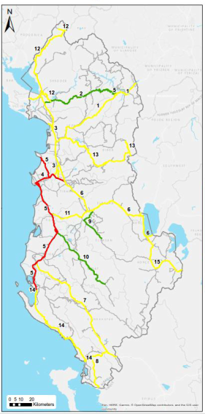
Criticality
Webinar : Developing risk and vulnerability assessments
Criticality determined during workshop with local stakeholders.
Take into account, importance for:
International connections
Industry
Harbour
Tourism
Evacuation

Slide 22
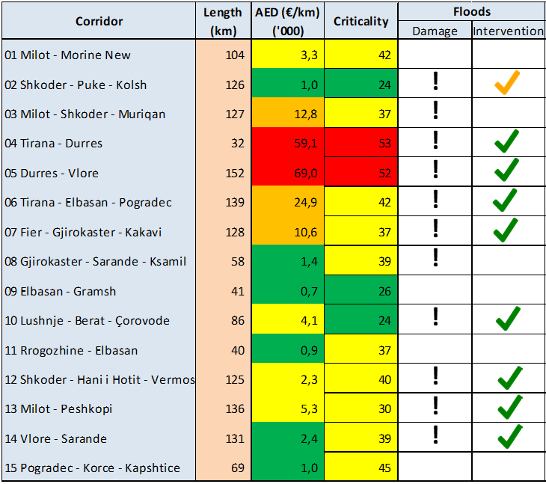
Action plan
Webinar : Developing risk and vulnerability assessments

Slide 23
Lessons learned 1
Webinar : Developing risk and vulnerability assessments
Desktop studies based on global data with coarse traffic data (corridor level) can produce useful and objective (strategic) results at a network level
  Results are a first scan at network level
  View input and results in this context
  Strategic assessment, not possible to downscale
  Field validation is required for next steps (execution of action plan)
  Are identified locations indeed vulnerable?
  Does cost estimate of measure fit with location?
  Update CBA if needed

Slide 24
Lessons learned 2
Webinar : Developing risk and vulnerability assessments
Sometimes difficult to find reliable input and data
  Damage functions
  Historical data (for validation)
  Repair costs, downtimes, cost of measures per corridor
  difference between ‘official input’ and ‘realistic input’
National input very important
  Local partners are vital (network, experience and validation)
  Interaction with local stakeholders (e.g. workshops)

Slide 25
Questions

Slide 26
Contact
www.deltares.nl
@deltares
linkedin.com/company/deltares
Mark.deBel@deltares.nl
@deltares
facebook.com/deltaresNL
facebook.com/deltaresNL
linkedin.com/company/deltares
@deltares
@deltaresNL

