Slide 1
Project development and planning
Key concepts Training on Financing and Economic Instruments for Climate Proofing and Green Infrastructure
Sabine McCallum 13 June 2022
©Sabine McCallum

Slide 2
Project development and planning
01 Develop a theory of change
Develop a Theory of Change for a project using the problem and objective analysis and determine an intervention logic, including drivers and assumptions
02 Design a logical framework
Design a Logical Framework that summarizes the project´s results and captures key elements along the result´s chain
03 Identify potential risks
Identify potential risks that the project may face and its management approaches

Slide 3
01 Theory of Change (ToC)
Initial step in planning is to clearly scope out the context in which the project aims to make a difference
Social
Environmental
Political
Economic
Technical
©Raimond Klavins/unsplash
©Casey Horner/unsplash
©Brett Jordan/unsplash
©Christine Roy/unsplash
©Sam Moghadam-Khamseh/unsplash
Developing a ToC includes three main steps:

Slide 4
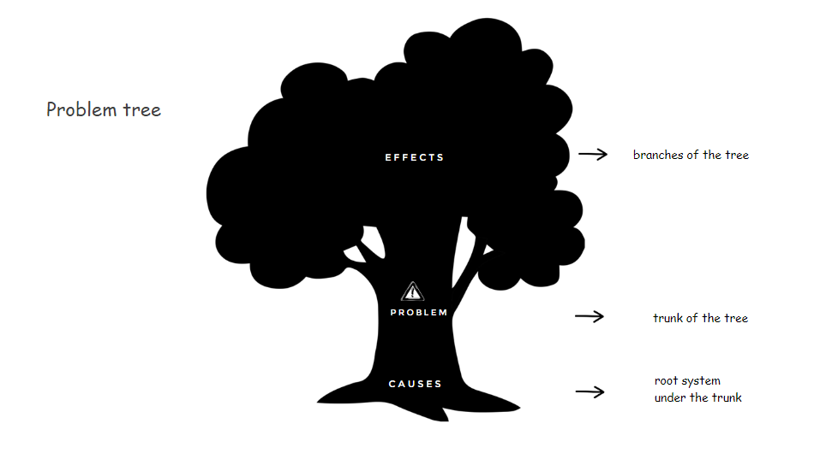
01a Problem and situation analysis
The problem or situation analysis can be done through development of a 'Problem Tree’ mapping out cause-and-effect relationships around an issue or problem in a structured manner
-> Effects of the problem are displayed as branches
-> “starter” problem that the project seeks to address
-> Underlying, root causes make up the root system

Slide 5
01a Problem and situation analysis
When stating problems, it is important to
clearly define the negative condition for example, "pollution is low political priority for the central government"
avoid stating a problem as a lack of something If you define a problem as a lack of funding, you may limit yourself to a single solution – money
By stating the causes and effects clearly and thoroughly,
it allows to identify who or what is affected by the problem Identifying affected parties helps to define the main stakeholders related to the problem so they can be addresses as a part of the project

Slide 6
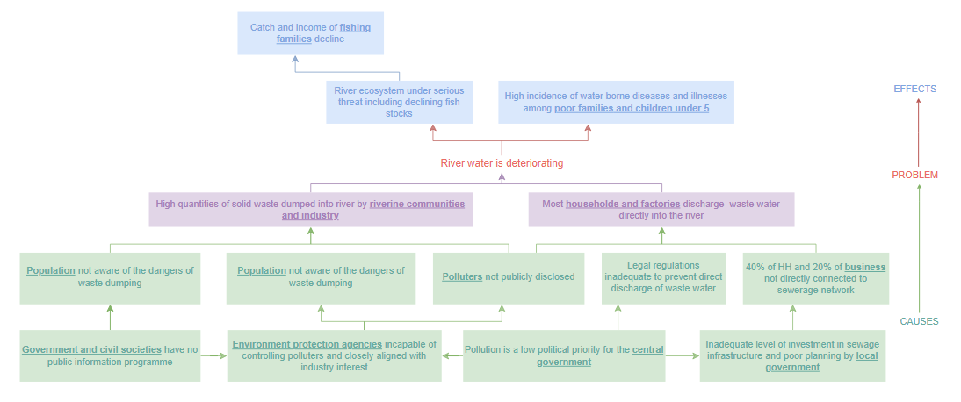
01a Problem and situation analysis
Example of a Problem Tree

Slide 7
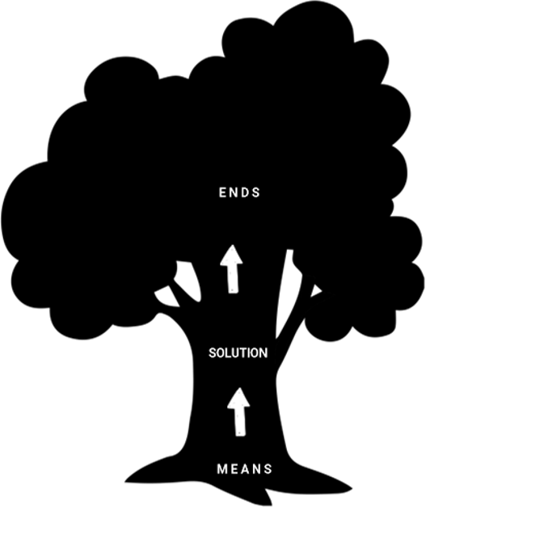
01b Objective analysis
The Problem Tree can be converted into an Objectives Tree by rephrasing each of the problems into positive desirable statements
-> The top of the tree shows the end that is desired
-> root causes and consequences that have been identified are addressed in the proposed solutions
-> Means to achieve the desired result/impact

Slide 8
01b Objective analysis
The Objectives Tree helps to establish priorities
assess how realistic the achievement of some objectives may be
identify additional means that may be required to achieve the desired ends

Slide 9
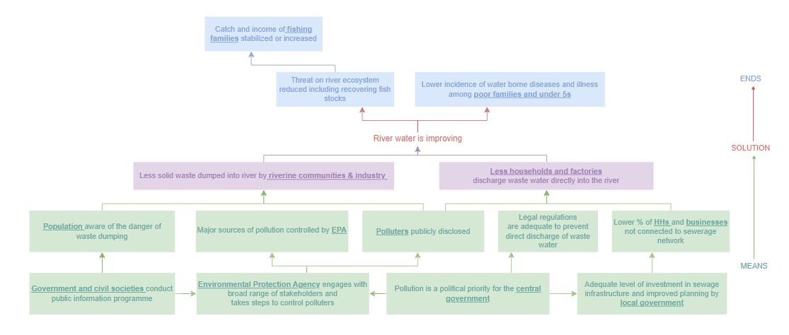
01b Objective analysis
Example of an Objective Tree

Slide 10
01c Intervention strategy (logic)
The Objectives Tree is the starting point for developing a Theory of Change diagram presenting the project's intervention logic or intervention strategy. This entails choosing the results chain of outputs, outcomes, intermediate state and impact following the “if we do A” - “then B happens” logic
The chosen intervention strategy should be as realistic as possible, taking into consideration the economic, political and socio-cultural dimensions in which the project shall be implemented

Slide 11
02 Logical framework

Slide 12
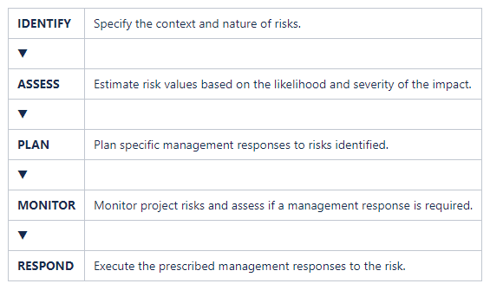
04 Risk management
Risk management at the project level are
mostly based on the following steps:
Project risks can involve both external and internal factors.
External risks are those that might occur outside the control of the project. They represent factors of the project environment including political, economic, environmental, and social conditions.
Internal risks are those that might arise from the management of the projects, such as inadequate human resources, lack of clarity in accountability, etc.

Slide 13
04 Risk management
Planning Management Responses to Risks (principal options)
Avoid: Change some aspects of the project so that the threat can no longer occur or have an impact.
Reduce: Decrease the probability of the event occurring or reduce the impact of the event should it occur.
Alternative Action: Prepare a contingency plan to reduce the impact of the threat should it occur.
Transfer: Ensure that a third party takes on responsibility for some of the impact.
Accept: Make a conscious and deliberate decision to accept the risk.
Monitoring Risk
Project Managers need to monitor and analyze project risks on a regular basis and implement the management responses as the risks emerge during project implementation (also often a reporting requirement!)

Slide 14
Thank you!
Sabine McCallum
sabine.mccallum@un.org
©Daniela Izotenko/unsplash

